Slide 1

Evaluation for survival probability and evaporation residue of synthesizing super heavy element
Nuclear Physics Theory Research 2017
FACULTY OF SCIENCE AND ENGINEERING
KINDAI UNIVERSITY
NUR LIYANA BINTI MOHD ANUAR, YOSHIHIRO ARITOMO,
SHOYA TANAKA, BAKU YANAGI

Slide 2

Content
Background/Objective
Model Explanation/Theory
Calculation Results
Survival probability
Evaporation residue cross section
comparison to experiment data
4. Discussion
5. Conclusion
Notes:
For today’s content, I will present about Background/Objective, Model Explanation/Theory, Calculation Results which include Survival probability,
Evaporation residue cross section and comparison to experiment value, Discussion and Conclusion.

Slide 3
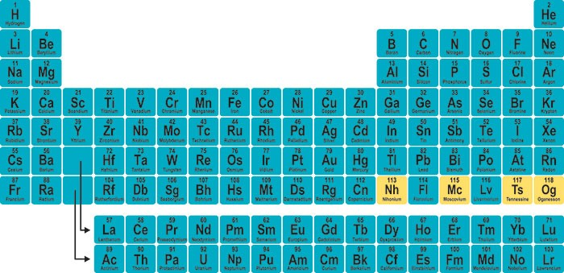
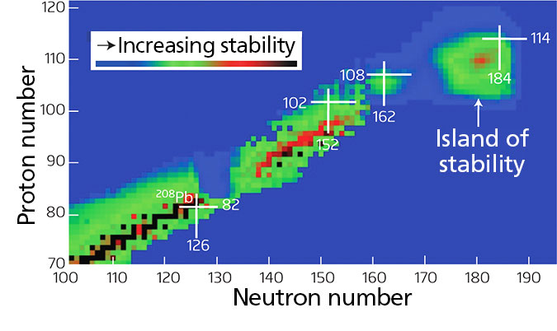
Background/Objective
NEW Superheavy element
Island of stability
Notes:
For Background and Objective, nowadays there are some new elements that had been discovered. For example, element 113 Nihonium, element 115 Moscovium, element 117 Tennessine and element 118 Oganesson. Its not the end. The periodic table will be continued to 8th period. Now we aim for element 119 and above.
From now on, there is still many unknown elements that had been not discovered yet.
Next, we aim the island of stability which, proton number Z 114, and neutron number N 184. Until now, there is still no stable combination of projectile and target nucleus.

Slide 4
Background/Objective
new
Superheavy element
2.Island of stability
Important to know evaporation residue
Fusion (formation) probability
Survival probability
Synthesizing
superheavy element
P_{for} x P_{sur} = P_{ER}
Notes:
From these two Backgrounds/Objectives, (new superheavy element and island of stability) its important to know the evaporation residue cross section of the compound nucleus. To know the evaporation residue possibility, we need to know Fusion probability (or formation probability) and Survival probability first. That’s why its important to synthesizing super heavy elements.

Slide 5
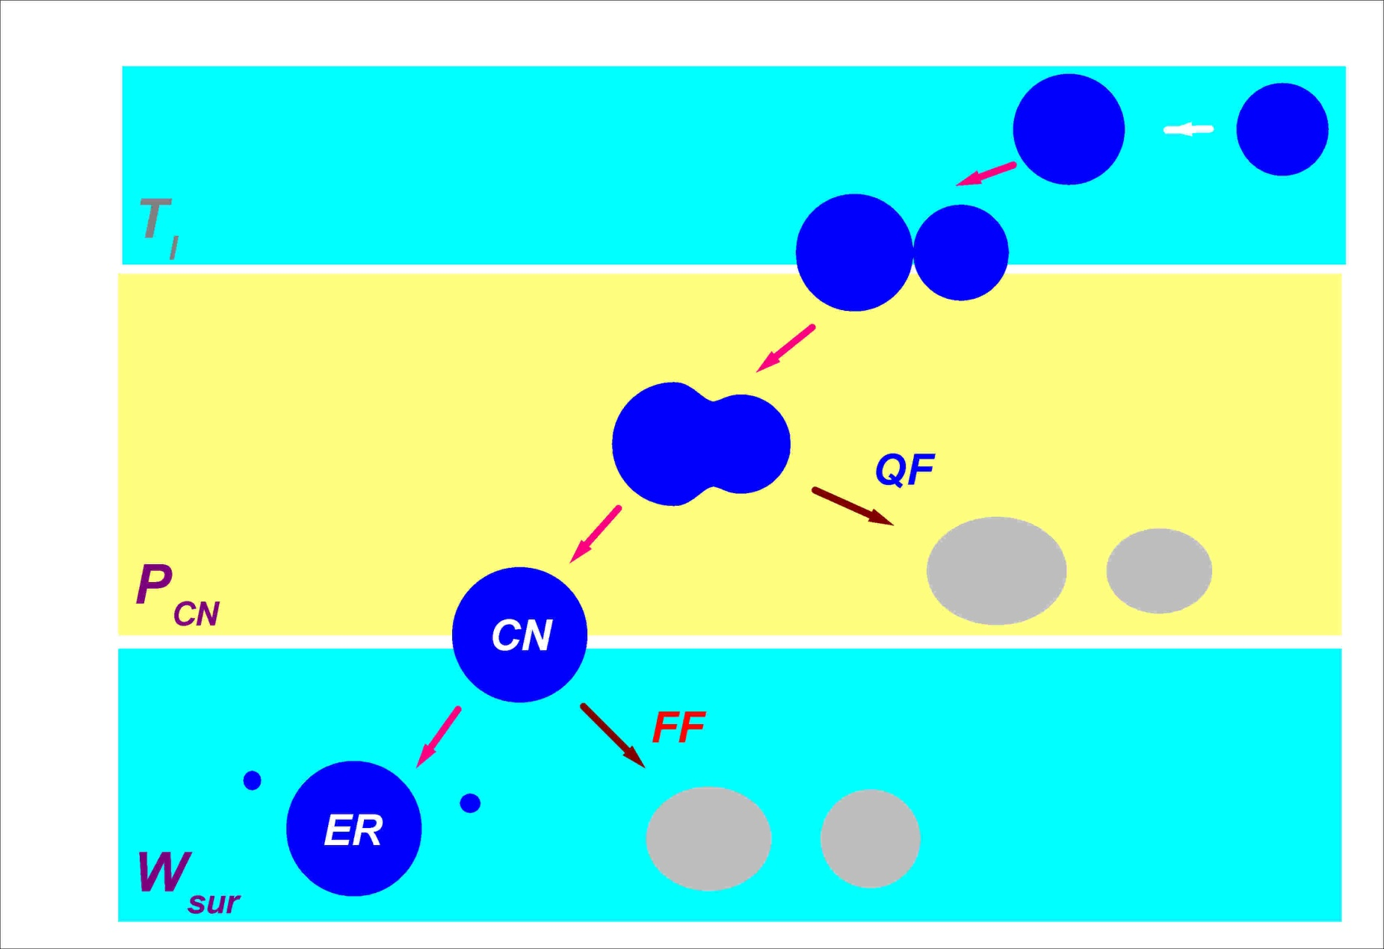
Model Explanation/Theory
Process of synthesizing superheavy element
Reaction time t < 10⁻²² s
1st
stage
Potential depth
Diffuseness
Kinetic energy dissipation
Target nucleus
Projectile
nucleus
Touching probability
10⁻²² < t < 10⁻¹⁸ s
Potential energy
Shape parameter
Transport coefficients
2nd
stage
Quasi-fission 90~99 %
Formation probability
Compound nucleus
~10⁻¹⁸ s < t
3rd
stage
Fusion-fission
Fission barrier height B_{f}
Friction parameter γ
af/an level density
Evaporation residue
Survival probability
Notes:
第１ステージ、第２ステージ、第３ステージを簡単に説明した後、
次のスライドにあるようにランジュバンの説明をするのだと思いますが、
あまり詳しく説明していると時間が足りなくなります。
なので、「これは第2ステージで使うランジュバン方程式です。」
だけでいいと思います。
「第３ステージは、統計模型を用いました。
このように統計模型では、分裂障壁の高さ、原子核の摩擦係数、準位密度
パラメータが含まれており、この値は、不定性を含んでいます。
（超重元素領域では、どんな値を使えばいいのか、正確には決まって
いません）」
これくらいの説明でいいと思います。
For Model Explanation and Theory, this figure is the Process of synthesizing super heavy element. Its divided into 3 stages depends on the different of reaction time. For the first stage which is touching probability is where the Projectile nucleus and target nucleus possibly touching. We use coupled channel model in this stage.
Move to the second stage, which is formation probability, which how much the possibility of compound nucleus will formed. Its about 1-10%. If its not formed a compound nucleus, quasi fission will occur. From this stage, we use Langevin equation, Dynamical model.
For the last stage which is survival probability, is the stage which ER are be formed. We use the statistical model in this stage.
There are some uncertain parameter in each stage, for example for the first stage, some uncertain parameter are potential depth, diffuseness and kinetic energy dissipation. Potential parameter like potential depth and diffuseness of compound nuclei are defined to reproduce the capture cross section. Kinetic energy dissipation is, how much the energy dissipate until it touches. There are some also situation that kinetic energy did not dissipate. We didn’t know that.
For second stage, Langevin equation are including Potential energy, shape parameter, transport coefficients and so on. This make the fusion region is unclear.
And for the last stage, in survival probability, it has fission barrier height parameter, friction parameter and level density parameter.
Here, we focused on the last stage, which is the survival probability.
These parameter is unclear for unknwon nuclei.

Slide 6
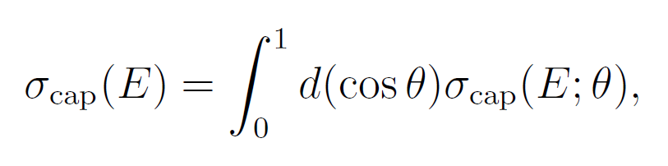
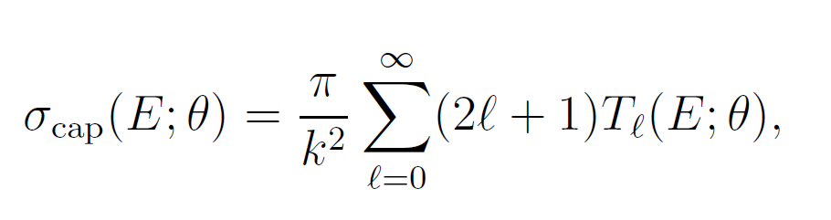
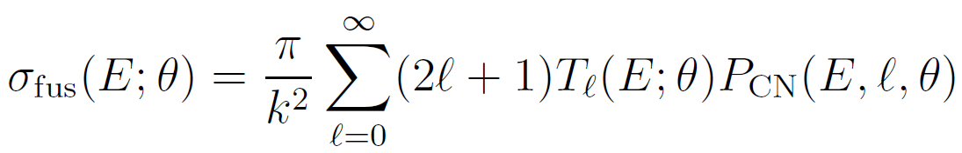
Model Explanation/Theory
Capture Cross Section
1st stage
R^{P}_{cm}
R^{E}_{cm}
θ: angle of incident projectile nucleus
R^{P}_{cm}
R^{E}_{cm}
Coupled-channel method
k: wave number of incident flux
Touching configurations for all orientations
Fusion Cross Section
2nd stage
CN
Formation probability P_{CN}
Dynamical calculation
Langevin eq.
Axial symmetric configuration
←start the Langevin calculation at the nose-nose configuration with each R_{cont} in 1st stage
Notes:
Using coupled channel model, we calculated the touching probability in first stage. When it touches, we use ‘center mass distance’ we take part in all orientation. (Because of the axis symmetry, if the touching probability at this side, we consider the touching probability will be like this)
From touching probability to formation of compound nucleus, we used Langevin equation.

Slide 7
Model Explanation/Theory
Langevin equation
Friction Random force
dissipation fluctuation
Newton equation
ordinary differential equation
Einstein relation
Fluctuation-dissipation theorem
random force
q_{i} : deformation coordinate （nuclear shape）
two-center parametrization (Maruhn and Greiner, Z. Phys. 251(1972) 431)
p_{i} : momentum
m_{ij} : Hydrodynamical mass (inertia mass）
γ_{ij}: Wall and Window (one-body) dissipation （friction ）
Temperature T
E_{int}=aT²
Notes:
これは第2ステージで使うランジュバン方程式です。
This is the Langevin equation that had been use in second stage. We use dissipation and fluctuation theorem. Γ is one body dissipation and m is hydrodynamical mass.

Slide 8
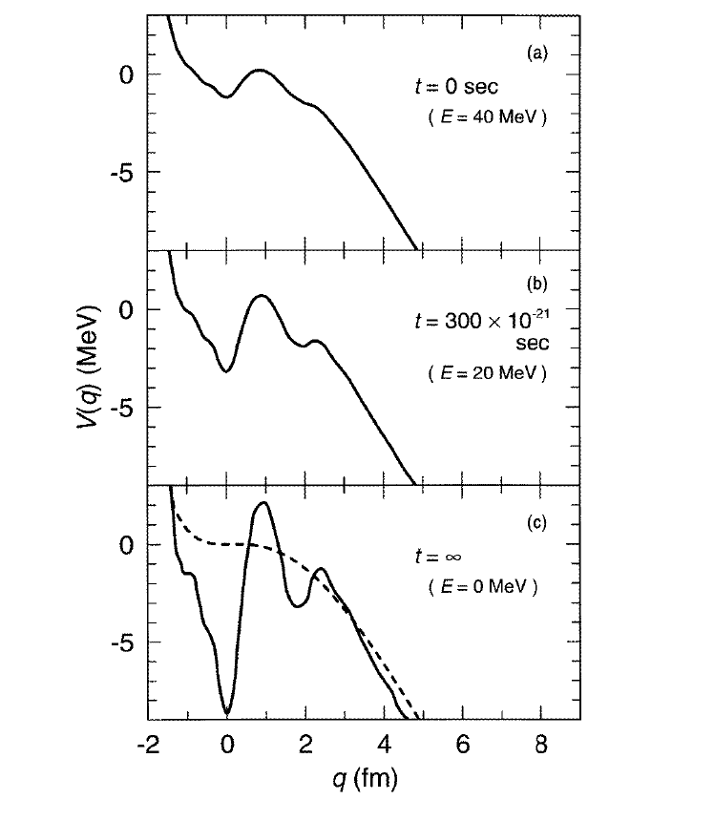
Temperature dependence of shell correction energy
²⁹⁸114
Potential energy
HIGH
T
LOW
T
deformation
Fission barrier recovers
at low excitation energy
Notes:
When the nucleus is at high temperature, the shell plus pairing correction energy disappear. It however restores as the nucleus cools down. (Thus, one of the most important ingredient is the shell and the pairing correction energies depending on the shape and temperature of composite system)
The temperature dependence factor expressed by ( )
Shell correction energy is low temperature. ----is high energy so, it cuts. that effect it can be in potential.

Slide 9
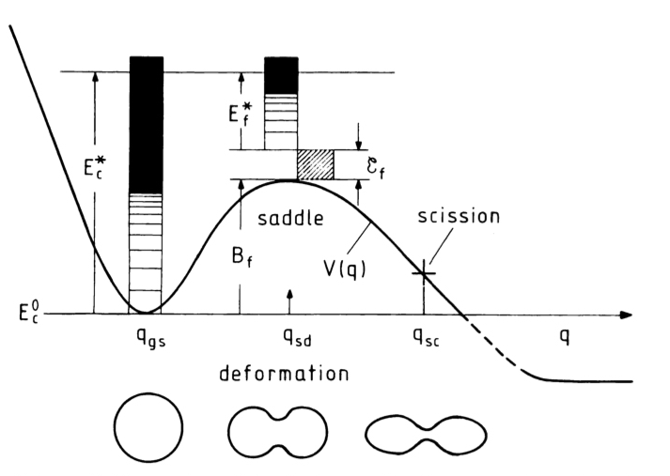

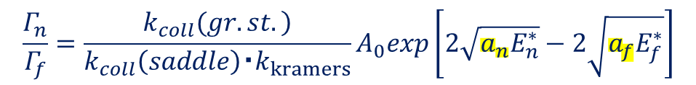
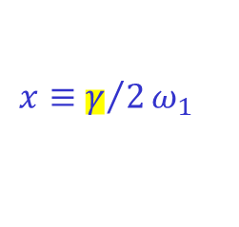
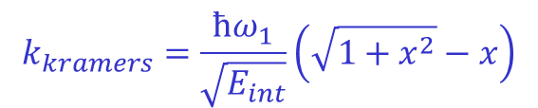
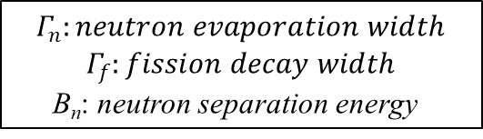
Model Explanation/Theory
3rd stage
Statistical Model
Survival probability
ℓ: angular momentum
μ₀: reduced mass in entrance channel
1. Fission barrier height B_{f}
2. Friction parameter γ
3. af/an level density
etc.
$$\frac{Γ_{n}}{Γ_{f}}=\frac{\left.k_{coll}(gr.st.\right)}{k_{coll}\left(saddle\right)・k_{kramers}}A_{0}exp\left[2\sqrt{a_{n}E_{n}^{∗}}−2\sqrt{a_{f}E_{f}^{∗}}\right]$$
$$E_{n}^{∗}=E_{int}−B_{n} , E_{f}^{∗}=E_{int}−B_{f}$$
$$k_{kramers}=\frac{ħω_{1}}{\sqrt{E_{int}}}\left(\sqrt{1+x^{2}}−x\right)$$
$$Γ_{n}:neutron evaporation width$$
$$Γ_{f}:fission decay width$$
B_{n}: neutron separation energy
$$x≡γ/2ω_{1}$$
Notes:
第３ステージは、統計模型を用いました。
このように統計模型では、分裂障壁の高さ、原子核の摩擦係数、準位密度
パラメータが含まれており、この値は、不定性を含んでいます。
（超重元素領域では、どんな値を使えばいいのか、正確には決まって
いません）
For third stage, we use statistical model. This is the equation of ER and this is the survival probability. W=π($\frac{Γ_{n}}{Γ_{f}}$)z. In survival probability, $\frac{Γ_{n}}{Γ_{f}}$is important. It has af and an. There is some uncertain value such as Fission barrier height parameter B_{f}, Friction parameter γ, level density parameter and so on. In the super heavy element region, it is not decided which value have to be used.

Slide 10
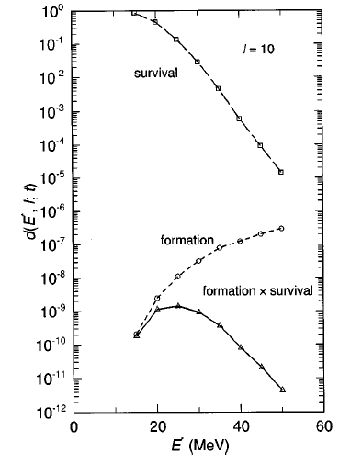
Calculation
survival
Statistical model
formation
P_{for} x P_{sur} = P_{ER}
Langevin eq.
formation
survival
1. Fission barrier height
2. Friction parameter
3. af/an
etc.
Y. Aritomo et al. PRC 59, 796 (1999)
Notes:
９枚目の説明は
第一ステージにカップルドチャネルモデル、第２ステージにランジュバン方程式
を用いて、この二つのステージから融合確率を計算します。
（グラフ中のformation を指し示す）
第３ステージでは統計模型を用いて、生き残り確率を計算します。
（グラフ中のsurvivalを指し示す）
この両者をかけて、蒸発残留核断面積を求めます。
今回は、この生き残り確率の計算に注目して、不定なパラメータの変動に
よる蒸発残留核断面積の影響を調べました
We used coupled channel Model for first stage, Langevin equation for second stage. From these two stages, formation probability can be calculated.
For statistical model in third stage, survival probability is calculated.
We used Langevin equation to calculate the formation probability and used statistical model to calculate survival probability. From these two probability (formation and survival probability) we can get the probability of ER.
In this time, we focused on survival probability and look how the uncertain parameter value change the effect ER cross section.

Slide 11
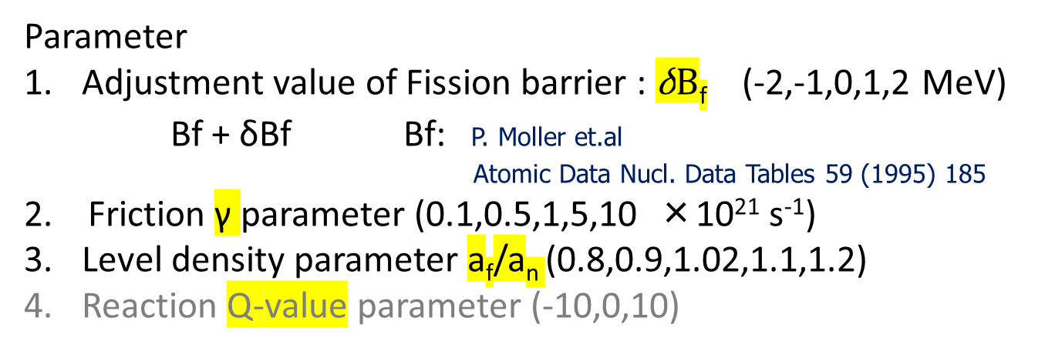
Calculation
Parameter
Adjustment value of Fission barrier : $\text{δ}B\text{f}$ (-2,-1,0,1,2 MeV)
Bf + δBf Bf: P. Moller et.al
Atomic Data Nucl. Data Tables 59 (1995) 185
2. Friction γ parameter (0.1,0.5,1,5,10 ×10²¹ s⁻¹)
Level density parameter a_{f}/a_{n} (0.8,0.9,1.02,1.1,1.2)
Reaction Q-value parameter (-10,0,10)
Calculated;
Excitation energy E* = 10,20,30,40,50 (MeV)
Super heavy Nuclei Z = 114～124
hot fusion
⁵⁴Cr+²⁴⁸Cm→³⁰²120
⁵⁴Cr+²⁴⁹Cf→³⁰³122
⁵⁶Fe+²⁴⁹Cf→³⁰⁵124
Z<114 cold fusion
Notes:
Bfに関しては、Bfの値をMoller の論文を参考にして、求めた
ということになっています。
実際はBfは液滴模型と殻補正エネルギーの和であらわされますが、
その殻補正エネルギーをMollerの論文から引用してきたという意味です
For this calculation, we change these uncertain parameter, which is Adjustment value of Fission barrier parameter : $\text{δ}B\text{f}$ , Friction γ parameter ,and Level density parameter a_{f}/a_{n} .
For fission barrier, we used Moller as the reference.
We had calculated the excitation energy E* from 10-50MeV and had calculated the superheavy nuclei z 110-124, the element that had been not discovered yet. We calculate from 110-124 to check the model uncertainty so that we can check whether the uncertainty effect the calculation or not. In last stage, We can look how these uncertainty parameters effect the evaporation residue cross section. We used cold fusion system for Z number less than 114 and hot fusion system for Z number more than 114.
As the reaction Q value parameter also effect the calculation result, we will change this parameter too.
This is the system, we calculated for the element that had been not discovered yet. For element 120 we used Chorium as the projectile and Curium as the target. While for element 122, chorium as a projectile and Californium as the target. For element 124, we used Ferum as the projectile nuclei and Californium as the target nuclei.

Slide 12
Calculation Results
⁷⁰Zn+²⁰⁸Pb→²⁷⁸Cn
112
114
probability
116
118
Notes:
Here is some example of calculation result to show the relation between formation cross section, survival probability and evaporation residue cross section. This is the example of calculation result for element 112, 114 116 and 118.

Slide 13
Calculation Results
Survival probability
Fission barrier parameter δBf
Friction parameter γ
Level density parameter af/an
Notes:
These 3 graphs are the graphs of survival probability base on different uncertain parameter value in third stage. This is the example for calculation results element 114, where Calcium as the projectile nuclei and Plutonium as the target nuclei.
As we can see, the uncertain parameter value effect the calculation results of survival probability.
As we can see, there are some different, gap, between the parameter.
The trend is same with other system for superheavy element. We change these parameter one by one.

Slide 14
Calculation Results
Evaporation residue cross section
Fission barrier parameter δBf
Friction parameter γ
Level density parameter af/an
Notes:
Next, these are the results of ER cross section base on different uncertain parameter value. As we can see also, because the survival probability change just now, the uncertain parameter value also effect the calculation result of ER cross section.
From these graphs, we took the maximum value of the ER cross section, and…….. (next page)

Slide 15
Calculation Results
⁶²Ni+²⁰⁸Pb→²⁷⁰Ds
⁶⁴Ni+²⁰⁹Bi→²⁷³Rg
⁷⁰Zn+²⁰⁸Pb→²⁷⁸Cn
⁷⁰Zn+²⁰⁹Bi→²⁷⁹Nh
⁴⁸Ca+²⁴⁴Pu→²⁹²Fl
⁴⁸Ca+²⁴³Am→²⁹¹Mc
⁴⁸Ca+²⁴⁸Cm→²⁹⁶Lv
⁴⁸Ca+²⁴⁹Bk→²⁹⁷Ts
⁴⁸Ca+²⁴⁹Cf→²⁹⁷Og
⁵⁰Ti+²²⁹Bk→²⁹⁹119
⁵⁴Cr+²⁴⁸Cm→³⁰²120
⁵⁴Cr+²⁴⁹Bk→³⁰³121
⁵⁴Cr+²⁴⁹Cf→³⁰³122
⁵⁶Fe+²⁴⁹Bk→³⁰⁵123
⁵⁶Fe+²⁴⁹Cf→³⁰⁵124
Notes:
plot it like had been showed in these graph. These are the summaries of all system that we had calculated from 110-124. As the Adjustment value of Fission barrier increase the ER cross section increase. Same goes to as the friction parameter increase, the ER cross section will increase too. Meanwhile as the level density parameter af/an increase the ER cross section will decrease. These parameters change was calculated one by one. These is the system that we used in this calculation. And for element that had been not discovered yet from 119-124 these are the system that we used.

Slide 16
Calculation Results
Maximum value of evaporation residue cross section
⁵⁶Fe+²⁴⁹Cf
⁵⁰Ti+²⁵⁰Cf
⁵⁰Ti+²⁴⁹Cf
⁵⁸Fe+²⁴⁸Cm
⁵⁴Cr+²⁴⁸Cm
⁵⁴Cr+²⁴⁹Cf
⁵⁸Ni+²⁴⁸Cm
Notes:
This is the maximum value of evaporation residue cross section. There are many possible system for synthesizing superheavy element, especially element that had been not discovered yet. For example, in this graph, for element 120, If we used other system, the calculation results are change too. For 122, if we used ⁵⁴Cr+²⁴⁹Cf system, the ER will be at this point, while if we used Fe+Cm, the calculation result will be like this. These result are not set the parameter (we use standard parameter)
Maybe Because it was not set to parameter.

Slide 17
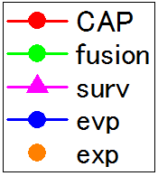
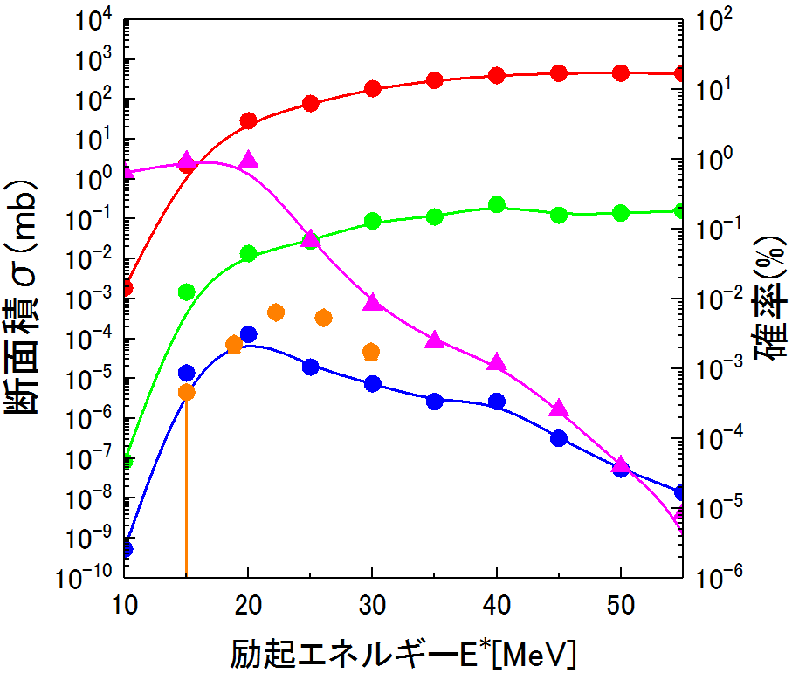
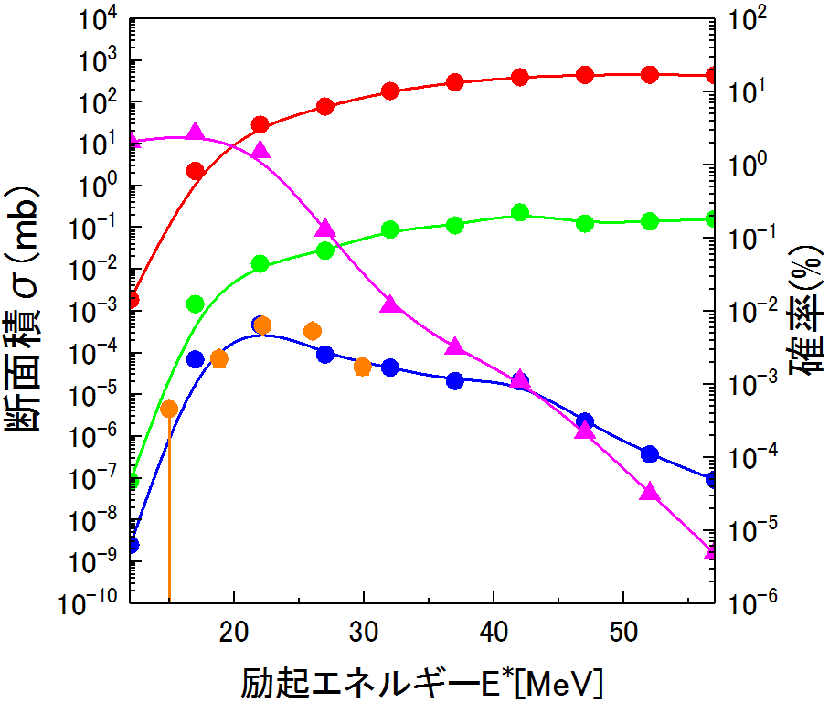
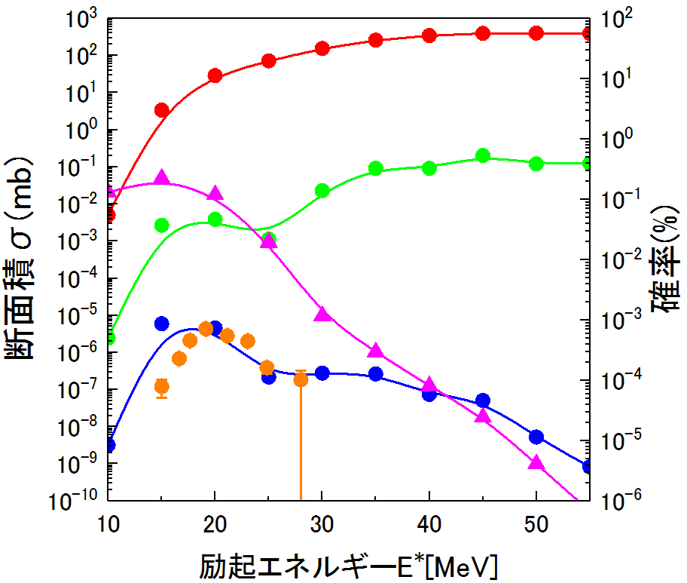
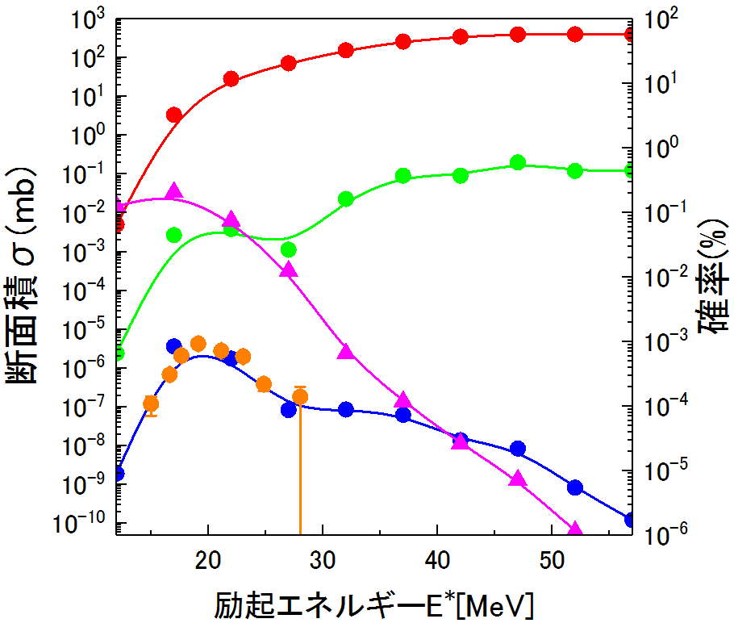



Discussion
Cross section σ(mb)
Probability (%)
Cross section σ(mb)
fric=2.5
δBf =-0.8
Probability (%)
$${}_{20}^{48}{\text{Ca}\text{+}{}_{83}^{208}{\text{Bi}}}{}_{103}^{257}{Lr}$$
${}_{20}^{48}{\text{Ca}\text{+}{}_{83}^{208}{\text{Bi}}}$→${}_{103}^{257}{Lr}$
Excitation Energy E* (MeV)
Excitation Energy E* (MeV)
Cross section σ(mb)
${}_{22}^{50}{\text{Ti}\text{+}{}_{83}^{209}{\text{Bi}}}$→${}_{105}^{209}{Db}$
Probability (%)
Cross section σ(mb)
${}_{22}^{50}{\text{Ti}\text{+}{}_{83}^{209}{\text{Bi}}}$→${}_{105}^{209}{Db}$
Probability (%)
fric=3
δBf =-0.2
Excitation Energy E* (MeV)
Excitation Energy E* (MeV)
J. Nakagawa (Kindai. Univ)
Notes:
For discussion, this is calculation by Jin Nakagawa in our group from Kindai University last year. This (at the left graph) is the calculation without changing the parameter value (using the default parameter set) Bf=0,γ=5,af/an=1.02. While this graph (right)is the calculation result after changing these parameter values (friction parameter and fission barrier height). For example, for calculation element 103 Lawrencium, if we change the friction parameter to 2.5 and Adjustment value of Fission barrier adds to -0.8MeV, the calculation result is almost matched with experiment data. The experiment data is from NRV data. For calculation element 105 Dubnium, if we change the friction parameter to 3 and Adjustment value of Fission barrier adds to -0.2MeV, the calculation result is almost matched with experiment data. This change was made manually.

Slide 18
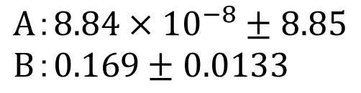

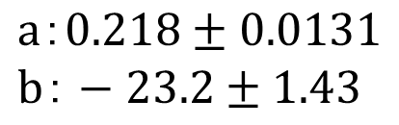

＊ δBf, fric Z-number dependence ＊
Discussion
Z | δBf
102 | -1
103 | -0.8
105 | -0.2
106 | 0.2
108 | 0.45
112 | 1
114 | 1.7
116 | 2.2
2.7
$$y=a×x+b$$
δBf [MeV]
$$a：0.218±0.0131$$
$$b：−23.2±1.43$$
Linear fit
119
Z number
Z | fric
102 | 2
103 | 2.5
105 | 3
106 | 4
108 | 5
112 | 10
114 | 12
116 | 20
31.8
$$y=A×exp\left\{B×x\right\}$$
$$A：8.84×{10}^{−8}±8.85$$
$$B：0.169±0.0133$$
Exponential fit
119
Z number
Notes:
From those calculations just now, we can make some function equation (as we can see, for adjustment of fission barrier height its linear fit, and for friction its exponential fit) and can predict the uncertain parameter value for the next next superheavy elements. For example, for element 119, we can predict like this

Slide 19
Conclusion
There are many uncertain values in this system
As the parameter change, the calculation results
are change too
We need to adjust the parameters to fit
with experiment value
To improve the accuracy of the calculation,
important to arrange it mathematically
(covariance method)
Others system
⁵⁰Ti+²⁴⁹Bk→²⁹⁹119
⁵¹V+²⁴⁸Cm→²⁹⁹119
⁴⁸Ca+²⁵⁴Es→³⁰²119
⁵⁰Ti+^{249,250,251}Cf→^{299,300,301}120
⁵⁴Cr+²⁴⁸Cm→³⁰²120
⁶⁵Cu+²³⁸U→³⁰³121
¹³⁶Xe+¹⁷⁰Er→³⁰⁶122
¹⁸⁰Hf+¹³²Xo→³¹²126
²³²Th+⁸⁰Kr→³¹²126
²⁵²Cf+⁶⁰Ni→³¹²126
Notes:
There are many uncertain values in synthesizing superheavy elements. As the parameter change, the calculation results is change too. we need to change these parameters to fit with experiment data.
For future task, I want to change and adjust these uncertain parameter, ( fission barrier height, friction parameter, level density parameter reaction Q value parameter etc) at the same time, and arrange it more mathematically using covariance method.
I hope with this and future calculation result, it will be helpful for the experiment team to be as a guide or make some prediction to discover more new elements.

Slide 20
Thank you

