Slide 1

Lattice QCD simulation with
exact chiral symmetry
--- Not yet at finite temperature ---
松古 栄夫 (hideo.matsufuru@kek.jp)
High Energy Accelerator Research Organization (KEK)
2008年9月3-5日 基研研究会「熱場の量子論とその応用」

Slide 2
Contents
Introduction
Lattice fermion actions
Overlap fermion
JLQCD's dynamical overlap project
Toward simulations at finite temperature
Summary/outlook

Slide 3
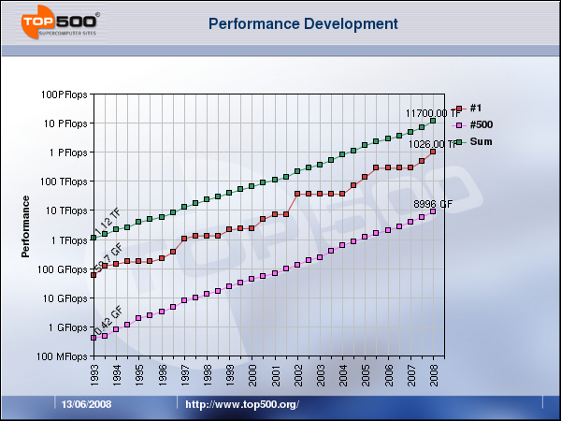
Introduction
Lattice QCD has been an application which requires most large computational resources
Growth of computational power → new era of lattice simulations
Around 2010, ~10PFlops expected
  Japan: Next generation supercomputer project (10TFlops in 2011)
  Two projects in USA
Earth Simulator
CP-PACS
KEK machine

Slide 4
Introduction
1980's
  Dawn of lattice simulations
1990's
  Large quenched simulations (w/o dynamical quark effect)
  Dynamical simulations (exploratory)
  Matrix elements with 10% accuracy: systematic errors from continuum/chiral limit, quenching
2000's
  Large dynamical simulations
  Chiral symmetry (domain-wall, overlap,...)
  Matrix elements with a few % accuracy
2010's ?
  Nuclear physics
  Thermodynamics
With accuracy!

Slide 5
Introduction
Our choice (JLQCD Collaboration): overlap fermion
Exact chiral symmetry (theoretically clean)
Large simulation costs (numerically challenging)
First large-scale dynamical simulation
Now rich results are coming
Toward finite temperature (and density) simulation
What kind of thermal properties to be explored?
Cost/interest

Slide 6
Lattice fermion actions
Notes:
Introduction.

Slide 7
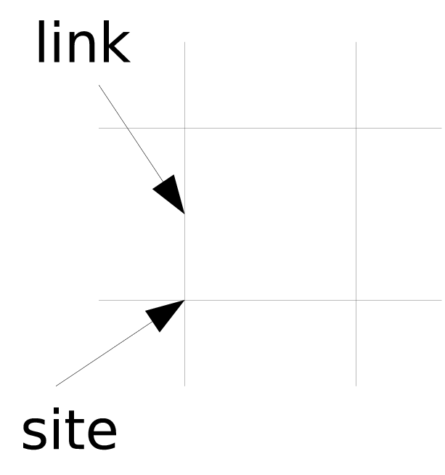
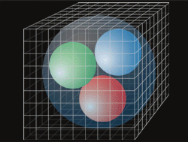
Lattice QCD
Lattice QCD: gauge theory on 4D Euclidean lattice
Regularized by lattice
  gluon: SU(3) link variables
  quark: Grassmann field on sites
Continuum limit (a→0) → QCD
Numerical simulation by Monte Carlo
Nonperturbative calculation
Quantitative calculation has become possible
  Matrix elements for flavor physics
  Phase structure/plasma properties
Chiral extrapolation is still a source of largest systematic errors!

Slide 8
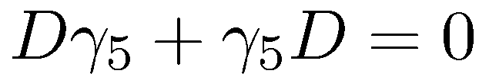
Femion doubling/Wilson fermion
Fermion doubling
naïve discretization causes 16-fold doubling
Nielsen-Ninomiya's No-go theorem
  Doublers appear unless chiral symmetry is broken
Wilson fermion
  adds Wilson term to kill 15 doublers
  breaks chiral symmetry explicitly → additive mass renorm.
  Improved versions, twisted mass versions are widely used

Slide 9
Staggered fermion
Staggered fermion
  16=4 spinors x 4 flavors ('tastes')
  Remnant U(1) symmetry
  Fourth root trick: still debated
  Numerical cost is low: popular at finite temperature/density

Slide 10
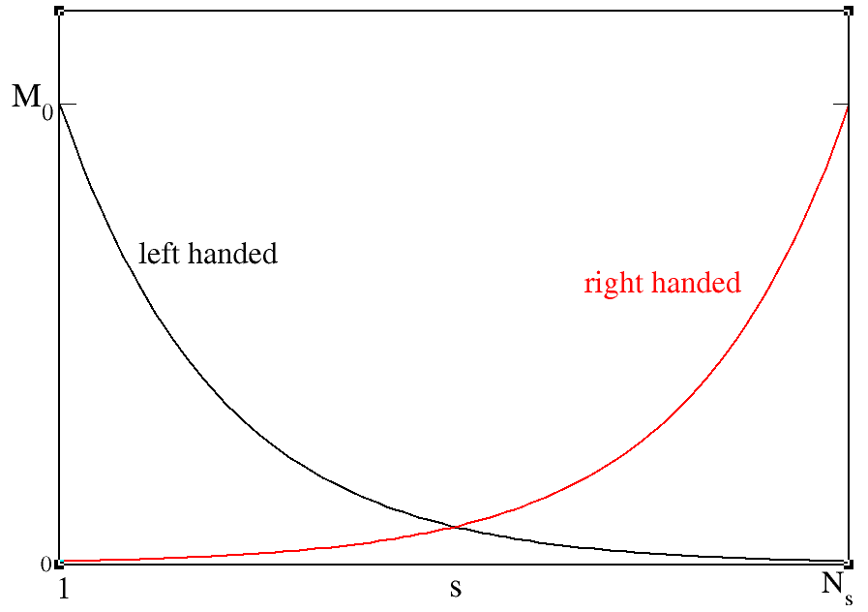
Domain-wall fermion
Domain-wall fermion (Kaplan 1992, Shamir 1993)
  5D formulation, light modes appear at the edges
  Symmetry breaking effect m_{res}  0 as N₅  
  Costs O(20) times than Wilson fermions

Slide 11
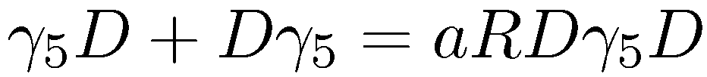
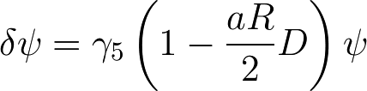
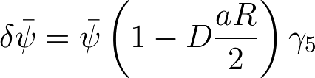
Chiral symmetry on lattice
Ginsparg-Wilson relation (1982)
  Exact chiral symmetry on the lattice (Luscher 1998)
Satisfied by
  Overlap fermion (Neuberger, 1998)
  Fixed point action (Bietenholz and Wiese, 1996)
Caution:
  Recently Mandula pointed out that Ginsparg-Wilson relation contains infinite number of lattice chiral transformation. What does this cause? [arXiv:0712.0651]

Slide 12

Overlap fermion
H_{W} : hermitian Wilson-Dirac operator
(Neuberger, 1998)
Theoretically elegant
  Satisfies Ginsparg-Wilson relation
  Infinite N_{s} limit of Domain-wall fermion (No m_{res} )
Numerical cost is high
  Calculation of sign function
  Discontinuity at zero eigenvalue of HW
Has become feasible with
  Improvement of algorithms
  Large computational resources

Slide 13
Costs
Large-scale dynamical simulation projects

Slide 14
Why overlap fermion?
Exact chiral symmetry
Exploring the chiral dynamics
  Confirming the chiral symmetry breaking scenario
  Epsilon regime
  Phase transition at T>0
Matrix elements with controlled chiral extrapolation
  no unwanted operator mixing
Testing the effective chiral Lagrangian predictions
  with exact chiral symmetry, continuum ChPT applies
Let us get rid of large cost by large computer power and
improved algorithms !

Slide 15
Overlap fermion
Notes:
Introduction.

Slide 16
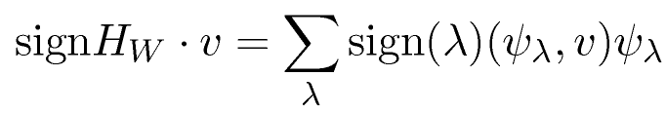
Overlap fermion
H_{W} : hermitian Wilson-Dirac operator
Sign function means:
  In practice, all eigenmodes cannot be determined
Reasonable solution:
  Eigenmodes determined at low frequency part
  Approximation formula for high mode part
    ex. Chebychev polynomial, partially fractional, etc.
(, ): eigenvalue/vector of H_{W}

Slide 17
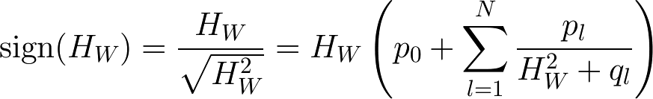

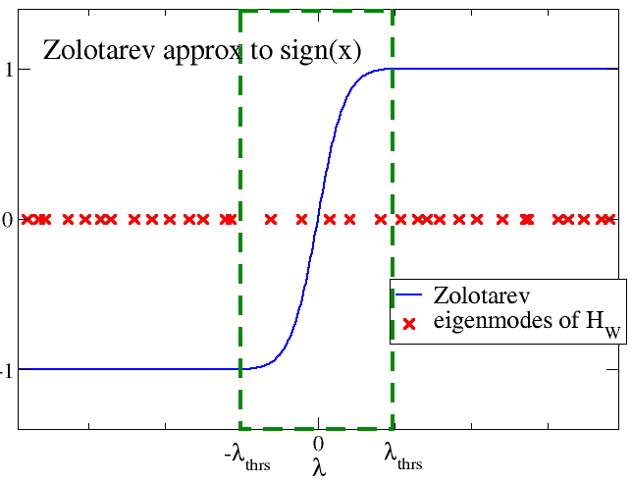

Sign function
Zolotarev's Rational approximation
  : calculable simultaneously
  Valid for |l| (eigenmode of H_{W}) [l_{thrs} ,l_{max}]
  Projecting out low-modes of H_{W} below l_{thrs}
  Cost depends on the low-mode density
(l_{thrs}=0.045, N=10 in this work)
Explicitly calculated

Slide 18
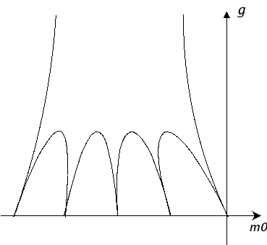
Locality
Fermion operator should be local
Overlap operator is exponentially local, if
  No low mode of H_{W} below some threshold
  Hernandez, Jansen, Luscher, 1999
  Near-zero mode is itself exponentially local
  Golterman, Shamir, 2003; Golterman, Shamir, Svetitsky, 2003
Out of Aoki phase
(parity broken phase)
-8
0

Slide 19
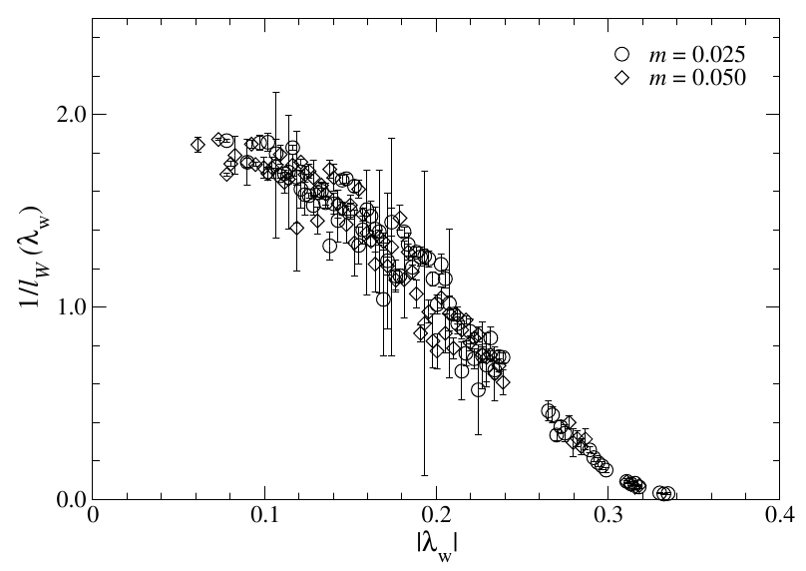
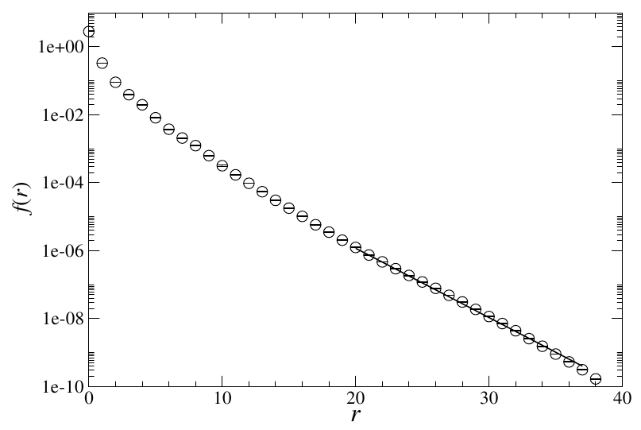
Locality
  JLQCD, 2008; JLQCD (Yamada et al.), Proc. of Lattice 2006
At beta=2.3 (Nf=2)
m=0.025
Localization length of low
eigenmodes of H_{W}
Localization of overlap operator
l = 0.25fm (~2a)

Slide 20
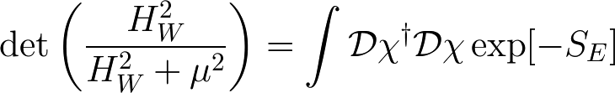
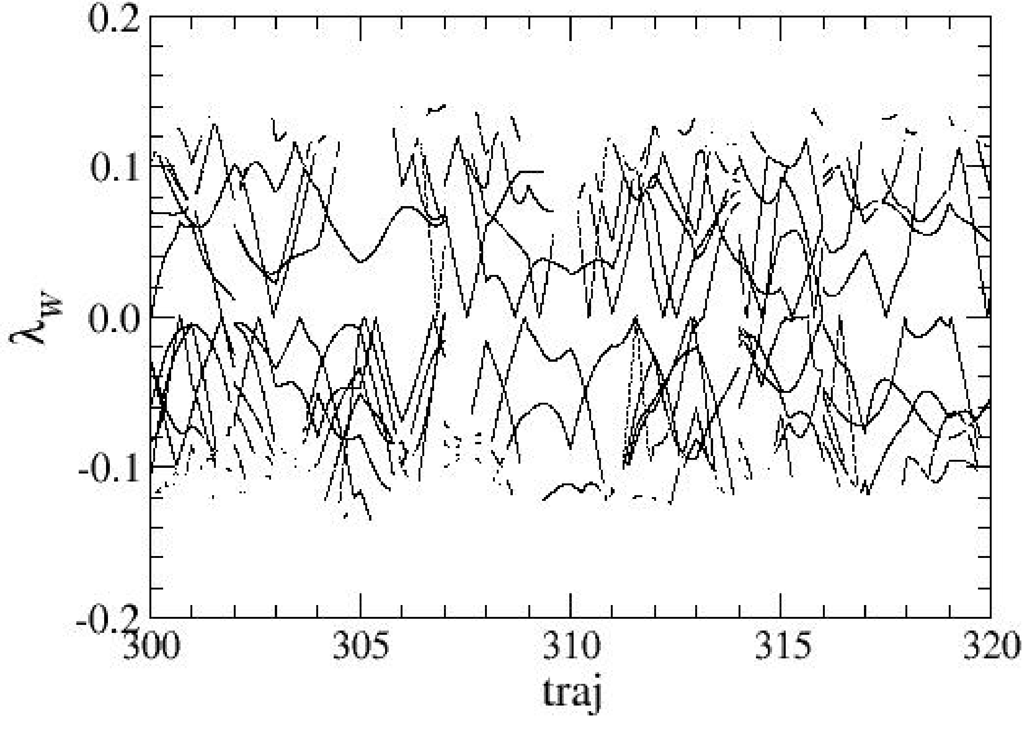
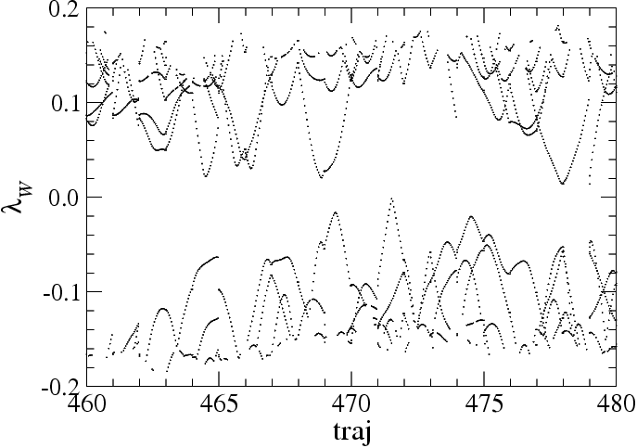
Simulation at fixed topology
Suppressing near-zero modes of H_W
  Locality of overlap operator
  Cost of dynamical simulation reduced
Achieved by extra-Wilson fermion term
  Twisted mass ghost: suppress high mode effect

Slide 21
Simulation at fixed topology
Forbidding near-zero mode of H_{W} ⇔ fixing topology
Is fixing topology a problem ?
In the infinite V limit,
  Fixing topology is irrelevant
  Local fluctuation of topology is active
In practice, V is finite
  Topology fixing finite V effect
  q=0 physics can be reconstructed
    Finite size correction to fixed Q result (with help of ChPT)
  Must check local topological fluctuation
  topological susceptibility, h' mass
  Remaining question: Ergodicity ?

Slide 22
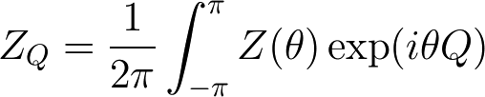


Physics at fixed topology
One can reconstruct fixed q physics from fixed Q physics
(Bowler et al., 2003, Aoki, Fukaya, Hashimoto, & Onogi, 2007)
Partition function at fixed topology
  For , Q distribution is Gaussian
Physical observables
  Saddle point analysis
for
  Example: pion mass

Slide 23
Large-scale simulation
of overlap fermion
Notes:
Introduction.

Slide 24
Collaboration
JLQCD Collaboration
  S.Hashimoto, T.Kaneko, J.Noaki, E.Shintani, N.Yamada, K.Takeda, H.Ikeda, H.M. (KEK)
  S.Aoki, K.Kanaya, Y.Kuramashi, Y.Taniguchi, A.Ukawa, T.Yoshie (Tsukuba Univ)
  H.Fukaya (Niels Bohr Institute)
  T.Onogi, H.Ohki (YITP, Kyoto Univ)
  K-I.Ishikawa, M.Okawa (Hiroshima Univ)
TWQCD Collaboration
  T-W.Chiu, K.Ogawa (Natl.Taiwan Univ)
  T-H.Hsieh (RCAS, Academia Sinica)

Slide 25
Project goals
Dynamical overlap simulations
  Exact chiral symmetry
  Small enough quark masses, e-regime
Since 2006 --- on new KEK system (x50 upgraded)
Let us try new formalism!
Goals:
Exploring the chiral regime
  Confirming the chiral symmetry breaking scenario
  Testing the effective chiral Lagrangian predictions
Matrix elements with controlled chiral extrapolation
  Without artificial operator mixing
  Precision computation for flavor physics

Slide 26
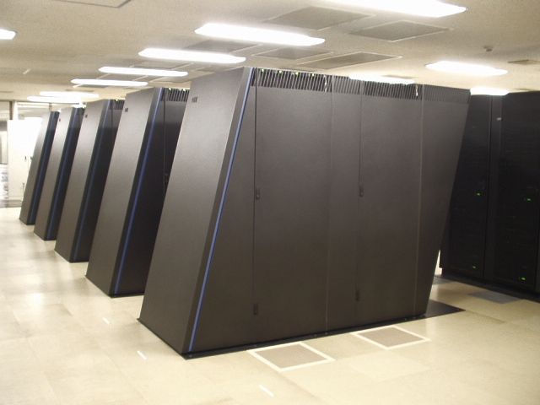
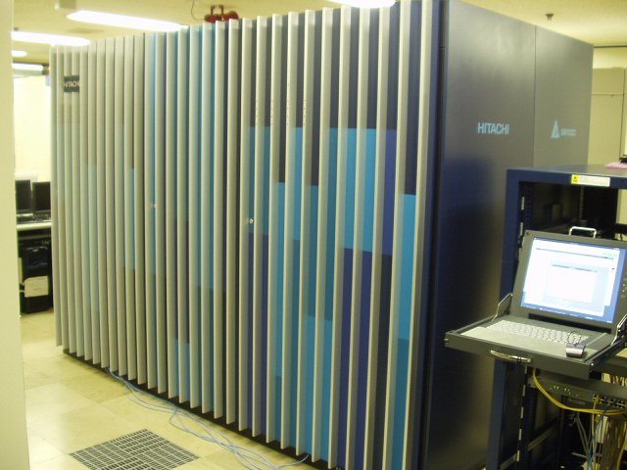
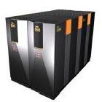
Machines
Main machine: IBM Blue Gene/L at KEK
  57.6 Tflops peak (10 racks)
  8x8x8(16) torus network
Hitachi SR11000 (KEK)
  2.15TFlops/0.5TB memory
NEC SX8 (YITP, Kyoto)
  0.77TFlops/0.77TB memory

Slide 27
Runs
Nf=2: 16³x32, a=0.12fm (production run finished)
  6 quark masses covering (1/6~1) ms
  10,000 trajectories with length 0.5
  20-60 min/traj on BG/L 1024 nodes
  Q=0, Q=−2,−4 (msea ~ ms/2)
  ε-regime (msea ~ 3MeV)
Nf=2+1 : 16³x48, a=0.11fm (production run finished)
  2 strange quark masses around physical ms
  5 ud quark masses covering (1/6~1)ms
  2500 trajectories with length 1
  About 2 hours/traj on BG/L 1024 nodes
Nf=2+1 : 24³x48 (just started)

Slide 28
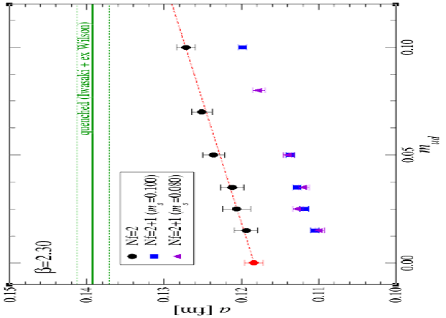
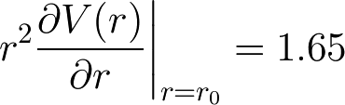
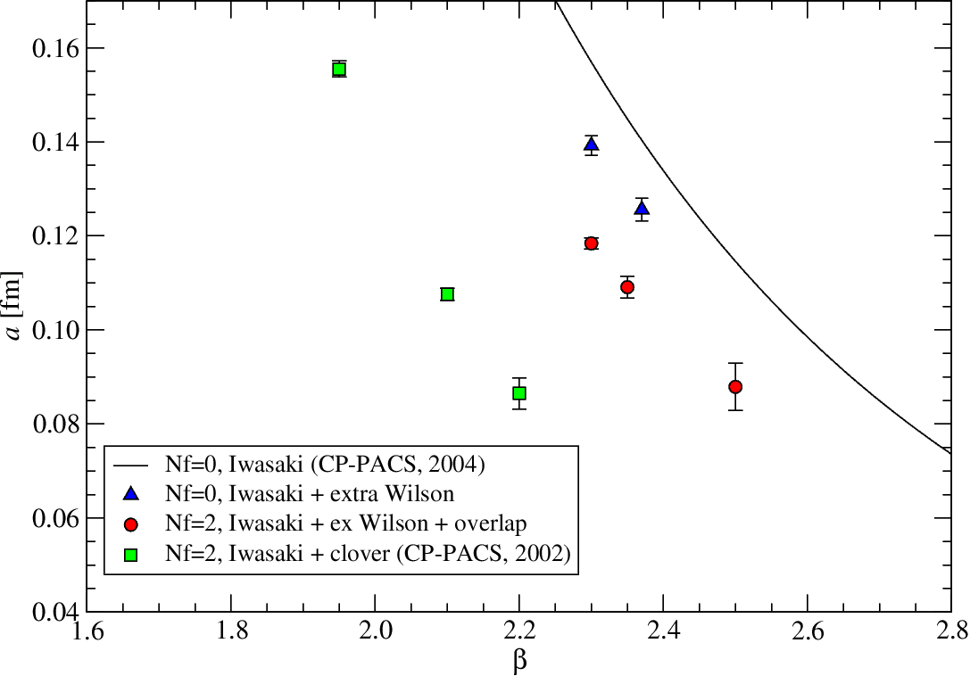
Lattice scale
Scale: set by r₀ = 0.49fm
  Static quark potential
  Milder b-shift than
  Wilson-type fermion

Slide 29







Chiral condensate
Banks-Casher relation (Banks & Casher, 1980)
  Accumulation of low modes Chiral SSB
: spectral density of D
e-regime: m << 1/SV at finite V
  Low-energy effective theory
  Q-dependence is manifest
  Random Matrix Theory (RMT)
Finite V
Notes:
The chiral condensate is related to the spectral density of the Dirac operator by celebrated Banks-Casher relation.
Thus the accumulation of the low-mode of D generates the spontaneous chiral symmetry breaking.
This relation is obtained in the limits of V goes to infinity first, and then m goes to 0.
In some cases, the opposite order of limits is useful.
The epsilon-regime is defined as the system in which the pion Compton wavelength is larger than the size of the system.
Then the behavior of the low-lying spectrum changes as
the figure.
In the epsilon regime, the low energy effective Lagrangian is applicable with the same parameter as the ordinary regime.
Q-dependence becomes manifest, so the fixed topology simulation is useful to determine the low energy constants.
Another advantage is that the chiral random matrix theory is expected to work, so the result can be comapred with its prediction.

Slide 30
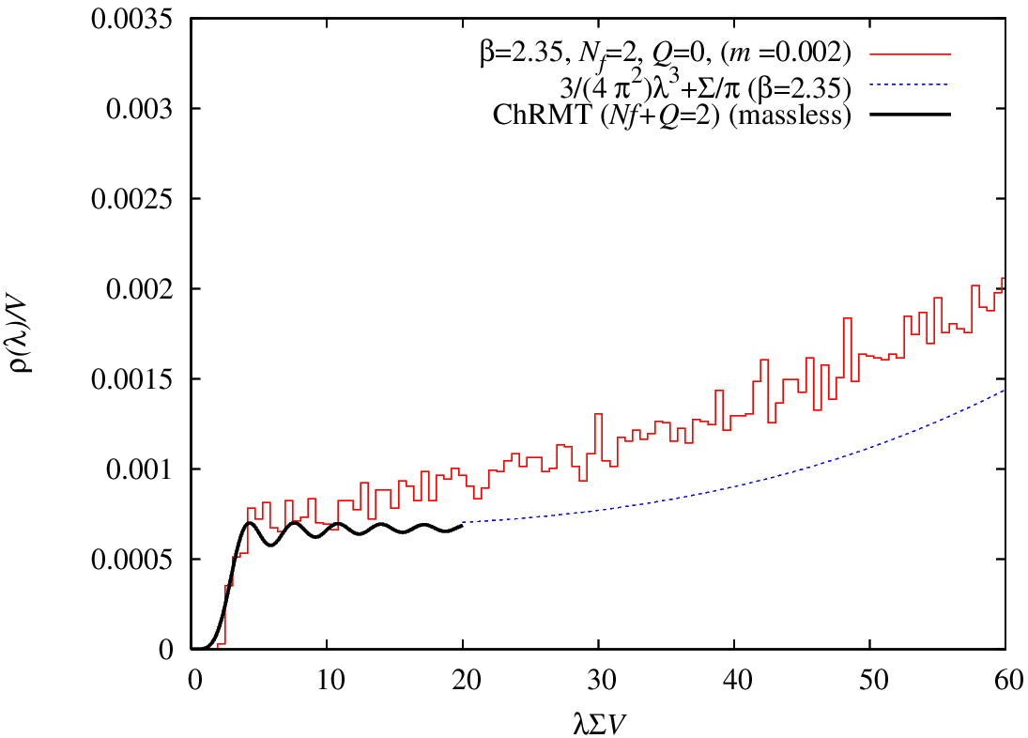
Result in the e-regime
(JLQCD, 2007, JLQCD and TWQCD, 2007)
  Nf=2, 16³x32, a=0.11fm
  m~3MeV
Good agreement with RMT
  lowest level distrib.
  Flavor-topology duality
Chiral condensate:
  Nonperturbative renorm.
    Low-lying spectrum of D(m)
O(e²) effect: correctable by meson
correlator
Notes:
The simulation is performed at Nf=2, and tiny quark mass.
The right figure shows the result of the low-lying spectrum of overlap Dirac operator.
We found good agreement with the random matrix theory, and then extract the chiral condensate from the distribution of the lowest level.
We also found so-called flavor-topology duality as displayed in the bottom figure.
This also indicate that RMT well explain the numerical result.
The chiral condensate is determined, with nonperturbative renormalization, as the following.
Here, the systematic error is due to the epsilon-squared effect, and further correction is possible using the meson correlator.
This subject is discussed in detail in Fukaya's talk.

Slide 31

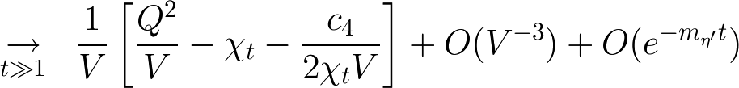
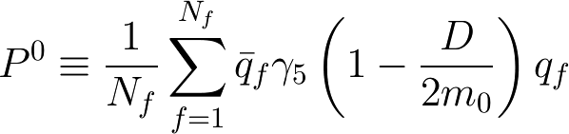
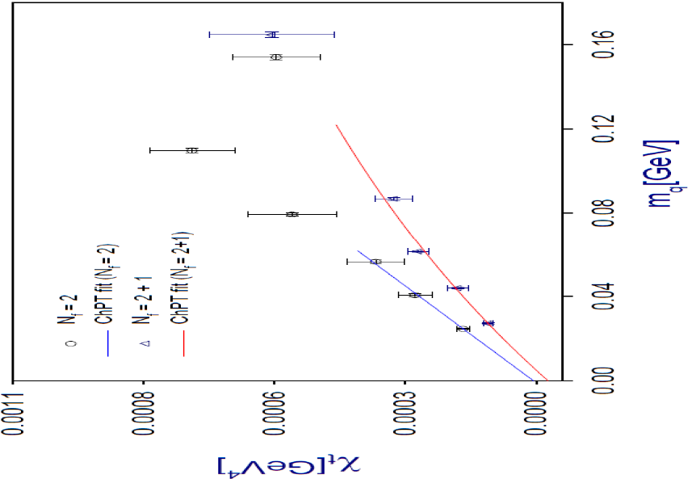
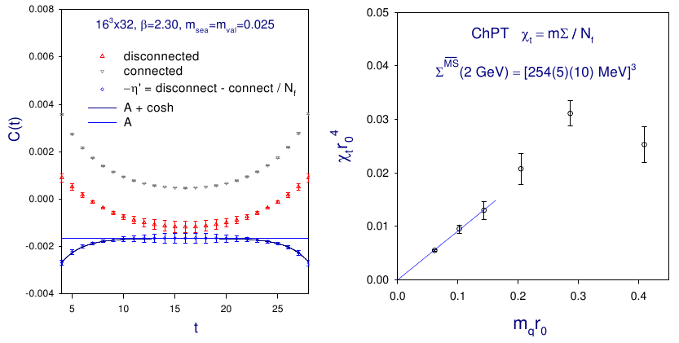
Topological susceptibility
Is local topological fluctuation sufficient ?
(JLQCD-TWQCD, 2007)
Topological susceptibility c_{t} can be extracted from correlation functions (Aoki et al., 2007)
where

Slide 32
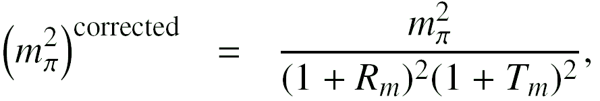
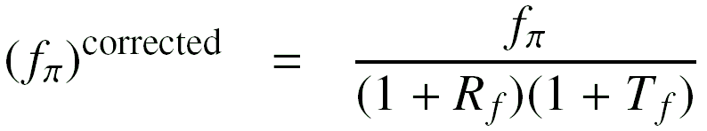
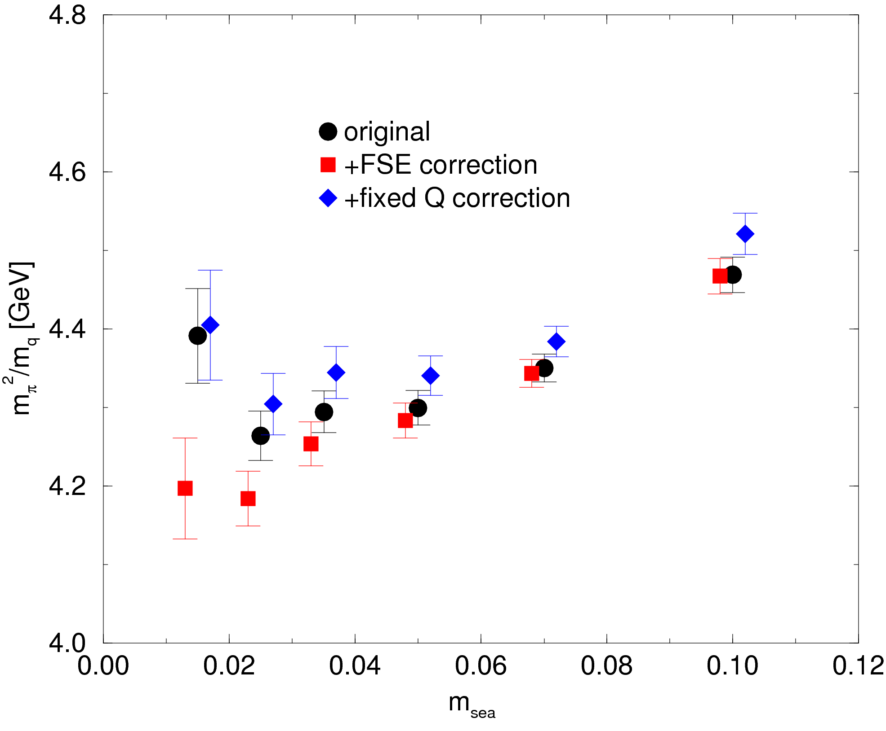
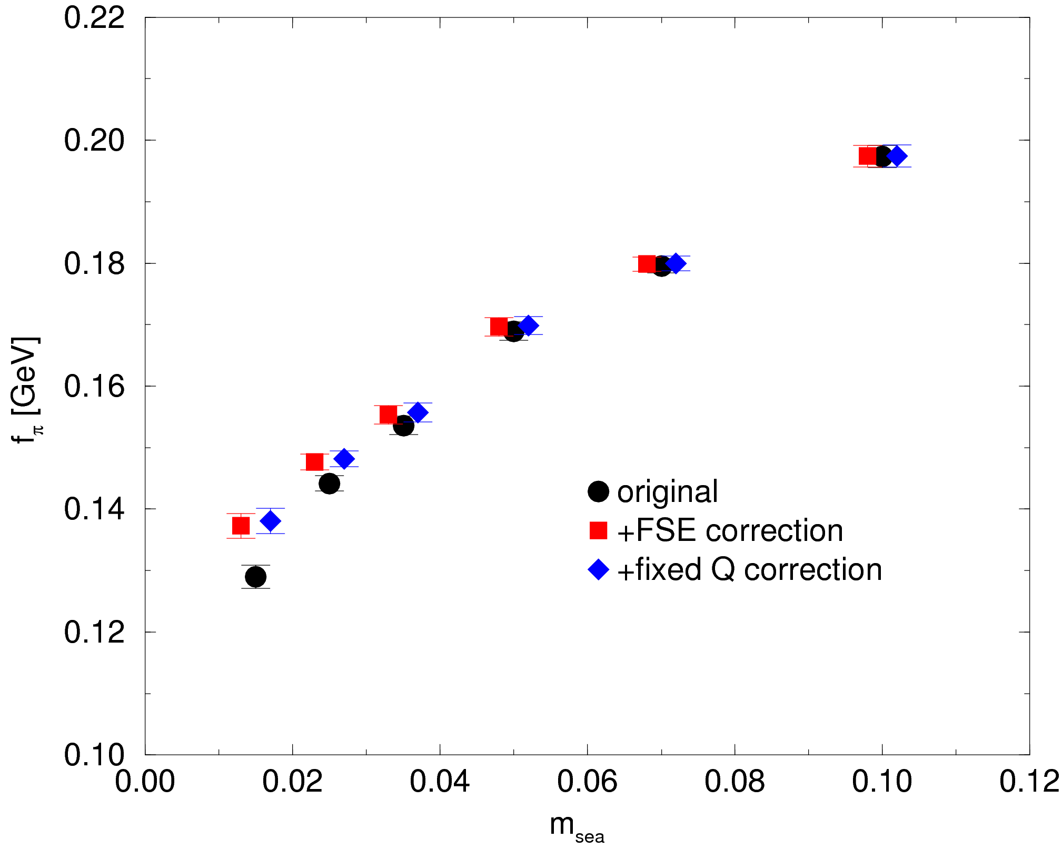
Meson spectrum: finite volume effect
JLQCD, arXiv:0804.0894
Finite volume correction
    R: ordinary finite size effect
  Estimated using two-loop ChPT (Colangelo et al, 2005)
    T: Fixed topology effect (Aoki et al, 2007)
  At most 5% effect --- largely cancel between R and T
  Nf=2, a=0.12fm, Q=0

Slide 33
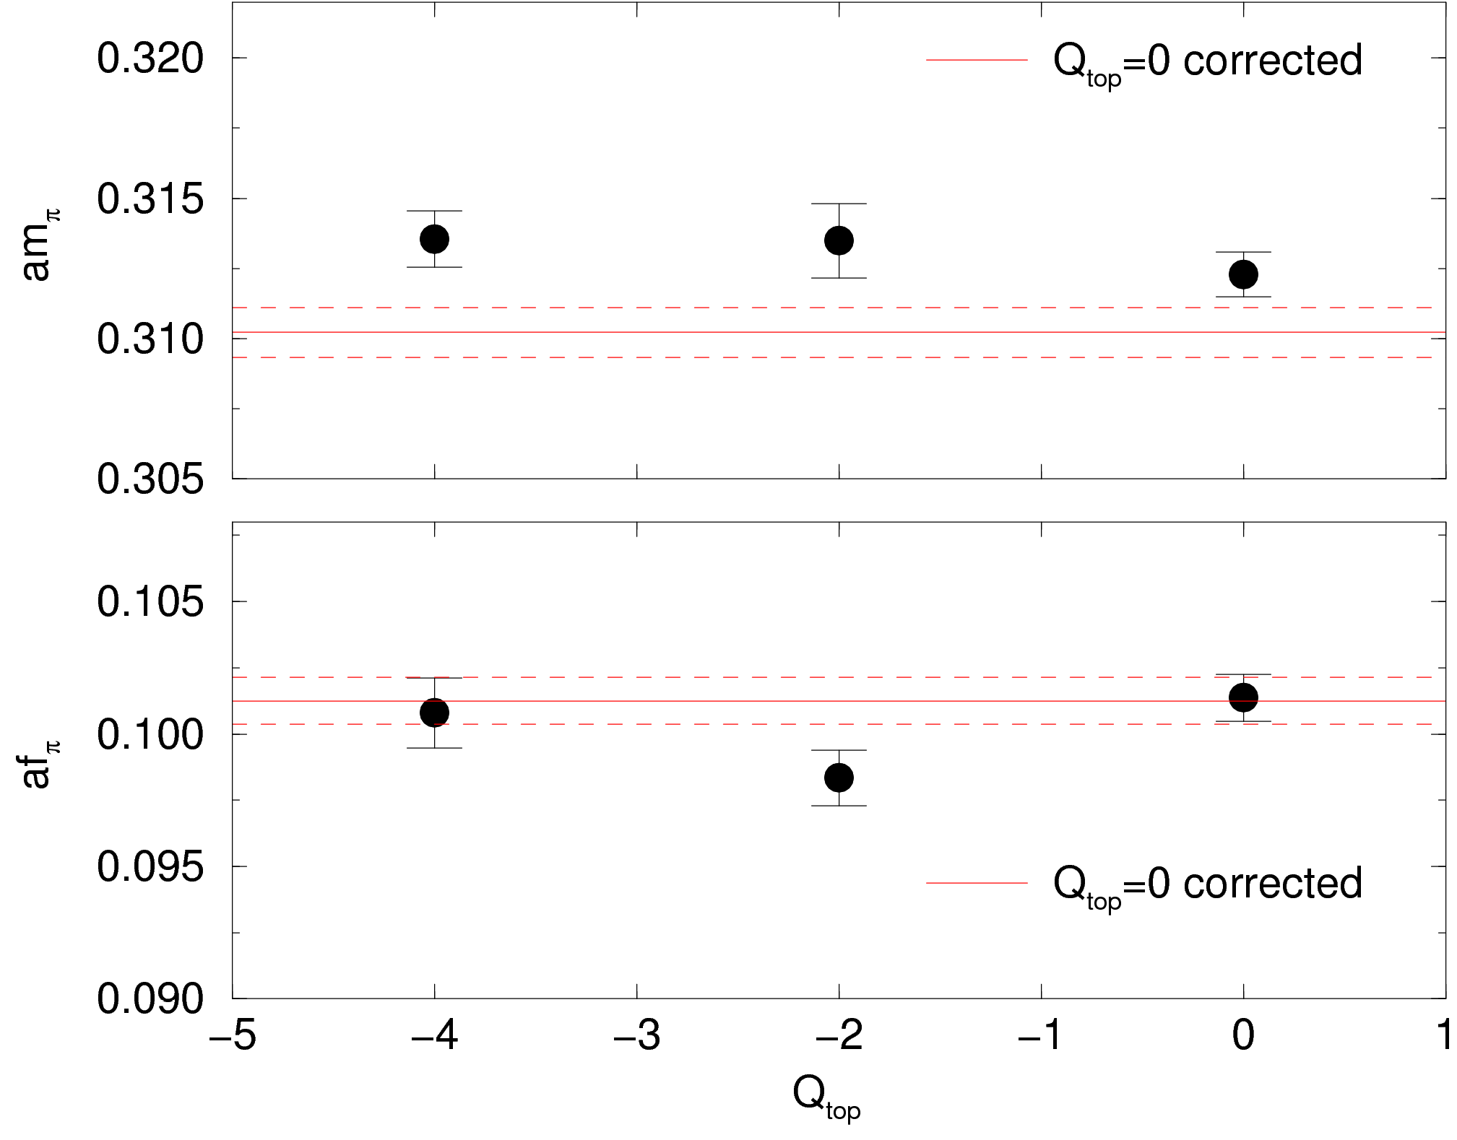
Meson spectrum: Q-dependnece
Nf=2, m_{sea} = 0.050
Q = 0, -2, -4
- No large Q-dependence
(consistent with expectation)
af_{p}

Slide 34
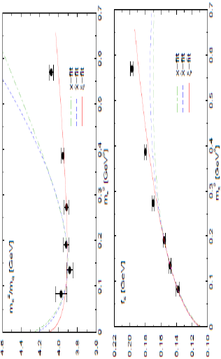
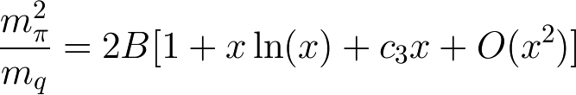
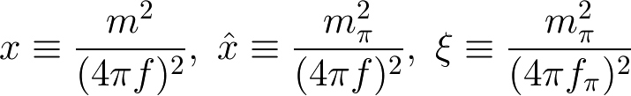
Meson spectrum: ChPT test
  Nf=2, a=0.12fm, Q=0
Chiral expansion
Continuum ChPT formula applicable
The region of convergence
JLQCD, arXiv:0804.0894
Expand either
ξ extends the region significantly

Slide 35
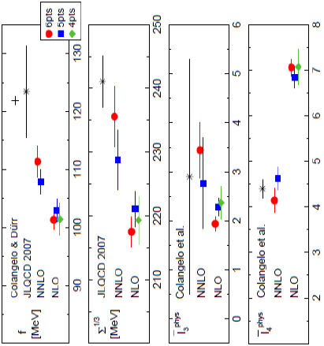
Meson spectrum: low energy consts
Low energy constants
--- NNLO fit with ξ
For reliable extraction of low
energy constant, NNLO terms
are mandatory

Slide 36
Other results
Physics publication: Cf. http://jlqcd.kek.jp/
  e-regime
  Topological susceptibility
  Meson spectroscopy and ChPT test
  p⁺-p⁰ mass difference
  Coupling const
  BK (Kaon bag parameter)
  Nucleon sigma term
  Ps-NG boson mass/S-parameter
  Pion form factors (in preparation)
  Nonperturbative renormalization (in preparation)

Slide 37
Toward overlap simulation
at finite temperature
Notes:
Introduction.

Slide 38
Lattice QCD at T>0
Phase diagram: still not conclusive
  Nf=2: expected O(4) scaling not observed in KS
    All recent works are with KS, Nt=4
    Work with Wilson fermion is not at enough small quark mass
  Nf=2+1 (physical point)
    Recently only with KS fermions, still large uncertainty
Finite chemical potential
  various methods proposed, but limited applicability
  still waiting a breakthrough!
Thermodynamics (equation of state, etc.)
Excitation spectrum
Viscosity

Slide 39
Toward overlap at T>0
Where overlap should be applied ?
Chiral symmetry is essential
KS and Wilson (and others) are inconsistent
Phase structure of Nf=2, 2+1
Vicinity of phase transition --- critical behavior ?
Observables concerning chiral symmetry and topological charge
For other topics,
Overlap costs too much
Other formulations are sufficient
Technical development is demanded

Slide 40
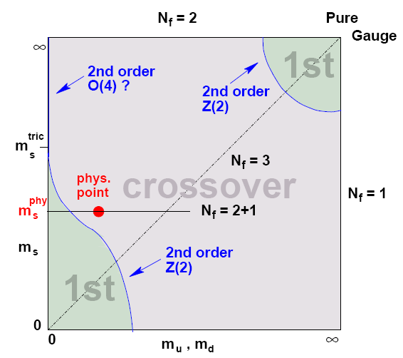
Phase diagram
Now popular phase diagram, but;
How reliable?
Consistency check enough?
Nf=2
KS fermion does not exhibit expected O(4) scaling
Wilson quark shows O(4), but at rather heavy masses
Most recent works are by KS, Nt=4.
(DeTar, Lattice 2008)
Nf=2+1 (physical point)
Really crossover ? [(old) Wilson result is of 1st order]
Recently only with KS fermions, still large uncertainty

Slide 41
Phase diagram
Nf=2 scaling study
Needs finite size scaling
Good reference work:
D'Elia, Di Giacomo, Pica, Phys. Rev. D72 (2005) 114510
Lattice simulation with
Staggered (unimproved)
Lt=4, Ls=12, 16, 20, 24, 32 → finite size scaling
am=0.01335 – 0.307036
Measure specific heat, susceptibility
Comparison with O(4), O(2), 2st order scaling

Slide 42
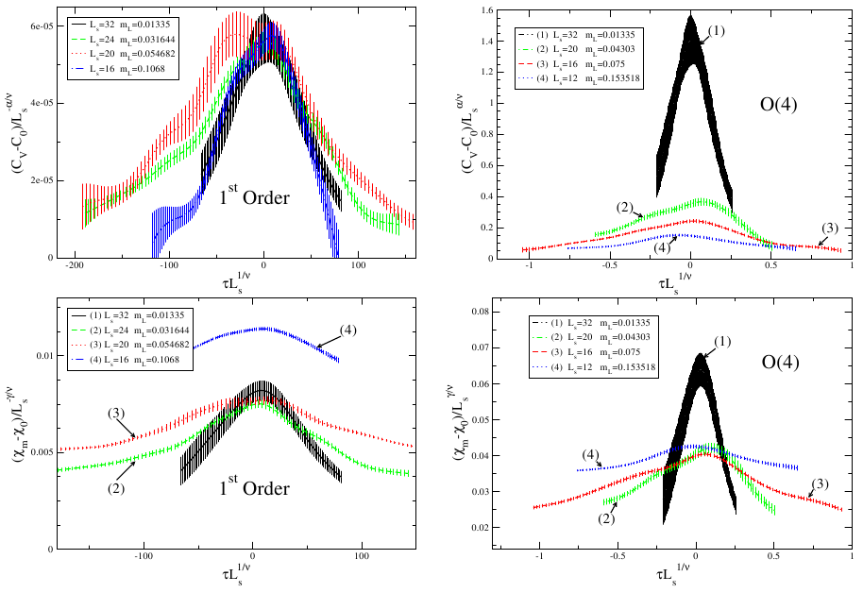
Nf=2 scaling study
Result (Cossu, D'Elia, Di Giacomo, Pica, PoS(LAT2007) 219):
Inconsistent with O(4) nor O(2)
Prefers 1st order (but not all quantities are consistent)

Slide 43
Toward overlap at T>0
To perform the same level of work with overlap fermion,
Suppose that simulation is possible at Nt=6
  Locality must be kept
  Not clear whether possible or not
  At least, around Ls=32 O(10000) trj x O(20) param. sets
  → 1-2 years on Blue Gene @KEK (57.3TFlops)
  Whole project 2-3 years (optimistic estimate)
At present, not realistic
  If performance is 5 times improved, may possible
  Next generation computer? (time passes so fast!)
  Within a few years, become feasible

Slide 44
Toward overlap at T>0
Preparation should be started
How 1/a can be reduced keeping locality ?
Fixed topology effect
  For matrix elements, finite size effect
  How about thermodynamic quantities, in particular critical exponent ?
Survey in parameter space (beta, quark mass, volume)
Fundamental thermodynamic quantities
Improved algorithms (always called for!)

Slide 45
Beyond QCD
Motivation:
What is relation between confinement and chiral symmetry breaking?
Phase structure of gauge theories
Advantages of exact chiral symmetry
Beyond QCD applications
Large Nf
Non-fundamental representations (adjoint, etc.)
Nc not 3
Confinement and broken chiral symmetry may not occur simultaneously

Slide 46
Summary/outlook
Overlap fermion has elegant chiral structure
Numerical cost is high
JLQCD is performing large dynamical overlap project at Nf=2 and 2+1
Rich physics results are being produced
Outlook
Simulation at finite temperature is challenging
Scaling study ?
Should start exploratory study
Beyond QCD simulations are interesting

