Slide 1
Extracting low-energy η-nucleon scattering amplitude from γ d → η n p data
Satoshi Nakamura (Osaka University)
Collaborators : H. Kamano (KEK), T. Ishikawa (Tohoku Univ.)

Slide 2
Introduction

Slide 3
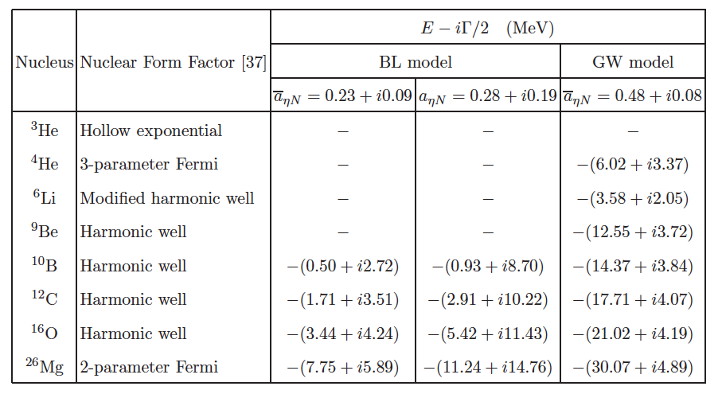
η N scattering length (a_{ηN})
a : scattering length
r : effective range
B.E. of various η-mesic nuclei from theoretical calculations
Governs low-energy behavior of η N scattering
→ important in its own right
Important relevance to the existence of η-mesic nuclei
Q. Haider and L. Liu, Int.J.Mod.Phys. E24 1530009 (2015)

Slide 4
η N scattering length (a_{ηN})
a : scattering length
r : effective range
But not well-determined yet
Current status
Several coupled-channels analyses of π N → π N and π N → η N data
Re[a_{ηN}] = 0.2 ∼ 1.1 fm
Im[a_{ηN}] = 0.2 ∼ 0.3 fm (optical theorem)
pn → dη data (WASA/PROMICE@COSY) Eur. Phys. J. A 38, 209 (2008)
Re[a_{ηN}] = 0.4 ∼ 0.6 fm
a_{ηN} determined with indirect information → model dependence
Need process that sensitively probes η N → η N , with other mechanisms under control

Slide 5
Proposed experiment at ELPH@Tohoku Univ.
γ d → η n p at Ε_{γ} ∼ 0.95 GeV and proton detected at 0º
An ideal kinematical setting for extracting η N scattering length
η is produced almost at rest → strong η n → η n rescattering is expected
π n → η n and NN rescatterings are expected to be suppressed
Data still need to be analyzed with reliable model to extract a_{ηN}

Slide 6
Dynamical Coupled-Channels (DCC) model for meson productions
Kamano, SXN, Lee, Sato, PRC 88, 035209 (2013)
PRC 94, 015201 (2016)
Developed through fully combined analysis of γΝ, πΝ ➔ πΝ, ηΝ, ΚΛ, ΚΣ data, W < 2.1 GeV
This talk
Show DCC model meets requirements to extract a_{ηN} from ELPH data
Develop γ d → η n p reaction model with DCC model as building block
Demonstrate model prediction agrees well with γ d → η n p data
Predict γ d → η n p cross sections at ELPH kinematics
Study sensitivity of ELPH exp. to a_{ηN} and r_{ηN}

Slide 7
Dynamical Coupled-Channels model for meson productions

Slide 8
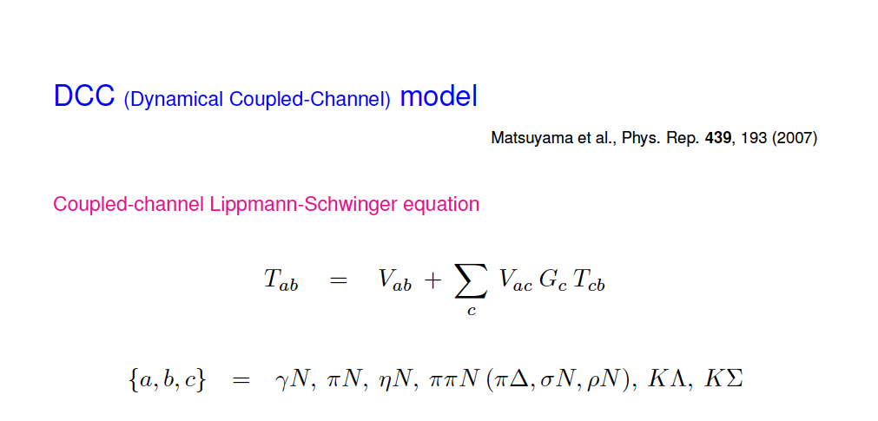
Kamano et al., PRC 88, 035209 (2013)
Coupled-channel Lippmann-Schwinger equation for meson-baryon scattering
,
By solving the LS equation, coupled-channel unitarity is fully taken into account
Both on- and off-shell amplitudes are calculated

Slide 9
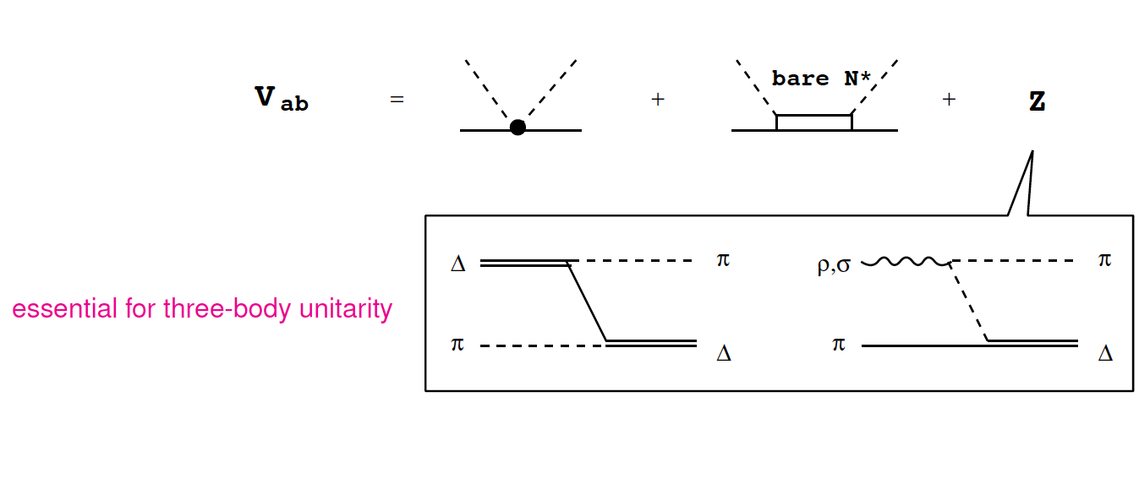
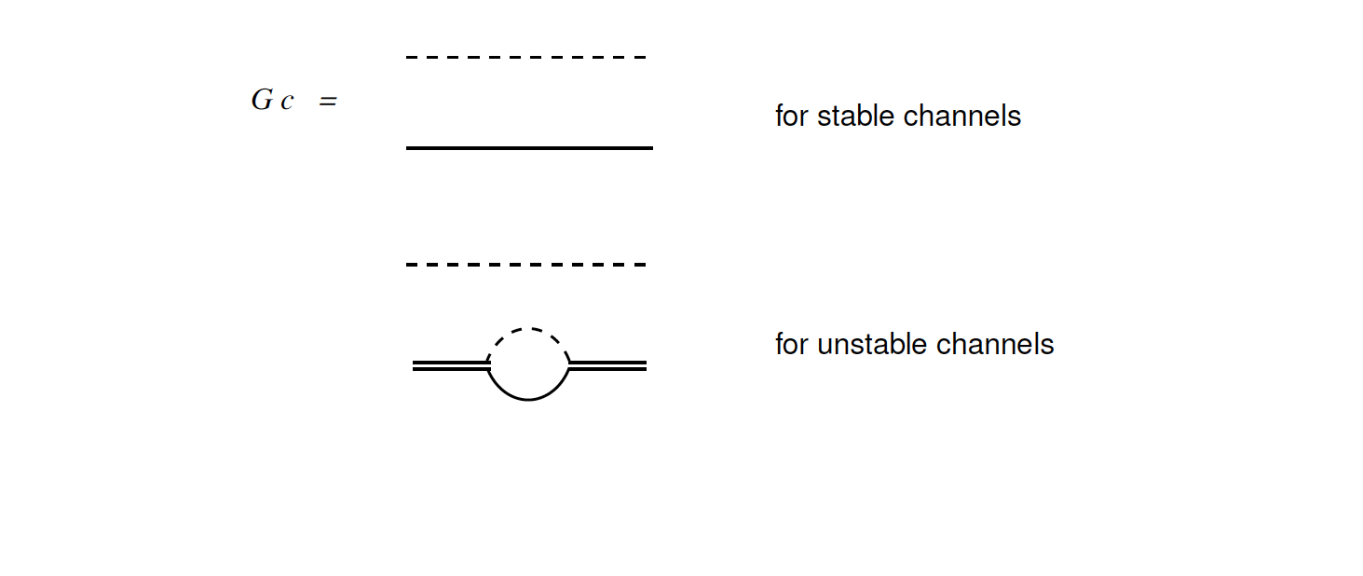
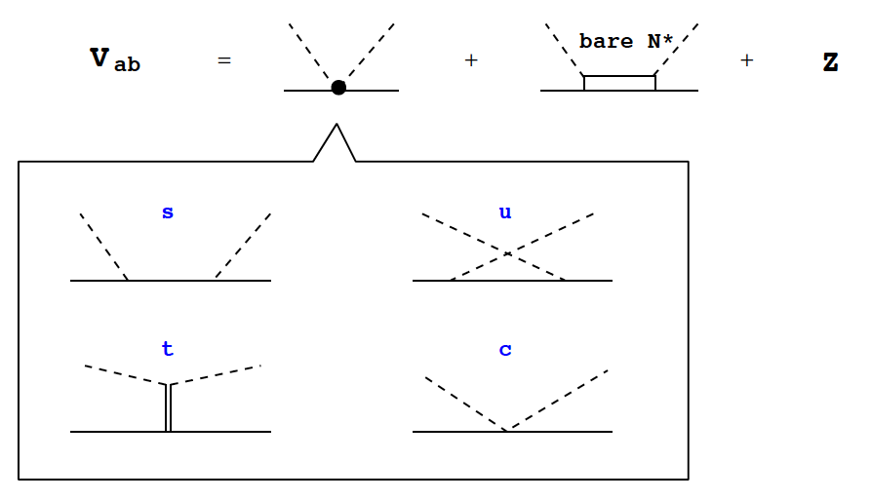
Kamano et al., PRC 88, 035209 (2013)
Coupled-channel Lippmann-Schwinger equation for meson-baryon scattering
1 or 2 bare N* in
each partial wave
,

Slide 10
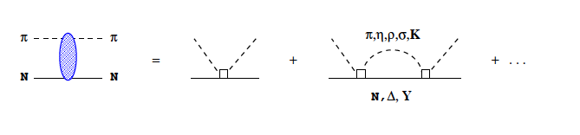
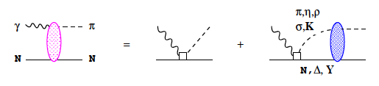
Kamano et al., PRC 88, 035209 (2013)
Coupled-channel Lippmann-Schwinger equation for meson-baryon scattering
,
T
V
V
V
By solving the LS equation, coupled-channel unitarity is fully taken into account
In addition, γΝ channels are included perturbatively
T

Slide 11
DCC analysis of γΝ, πΝ ➔ πΝ, ηΝ, ΚΛ, ΚΣ

Slide 12
DCC analysis of meson production data
Kamano, Nakamura, Lee, Sato, PRC 88 (2013)
PRC 94 (2016)
Fully combined analysis of γΝ, πΝ ➔ πΝ, ηΝ, ΚΛ, ΚΣ data
and polarization observables
(W ≤ 2.1 GeV)
~ 23,000 data points are fitted
by adjusting parameters (N* mass, N* ➔ MB couplings, cutoffs)

Slide 13


Eta production reactions
Database carefully selected in Durand et al. PRC (2008)
Relevant to π n → η n rescattering
in γ d → η n p reaction
Kamano, Nakamura, Lee, Sato, PRC 88 (2013)

Slide 14
γp → π⁰p
dσ/dΩ for W < 2.1 GeV
Kamano, Nakamura, Lee, Sato, PRC 88 (2013)
Kamano, Nakamura, Lee, Sato, 2012
Relevant to π exchange mechanism
in γ d → η n p reaction

Slide 15
γ p → η p
Kamano, Nakamura, Lee, Sato, PRC 88 (2013)
Important elementary amplitudes for γ d → η n p tested
relevant to impulse and η n → η n rescattering mechanisms

Slide 16
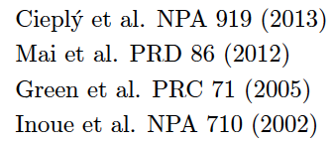
η N → η N S-wave amplitude
CS
MBM
GW
IO
η N → η N S-wave amplitude is
rather model dependent
DCC analysis covered data much more
extensive than the others
→ meson-baryon dynamics could be
better constrained
DCC (2016)
a_{ηN} = 0.75 + 0.32 i
r_{ηN} = −1.6 − 0.6 i

Slide 17
Application of DCC model to γ d → η n p reaction

Slide 18
Model for γ d → η n p
Impulse
ΝΝ rescattering
πΝ & ηN rescattering
η
N
N
T_{NN}
π, η
γ
d
d
d
γ N → π N, η N amplitude ⬅ DCC model
π N, η N → η N amplitude ⬅ DCC model
Τ_{ΝΝ} , deuteron w.f. ⬅ CD-Bonn potential (PRC 63, 024001 (2001) )
Off-shell effects are taken into account

Slide 19
Numerical results for γ d → η n p

Slide 20
Comparison with data for η angular distribution in γ d → η X
( γ d → η d is small )
Data: Krusche et al.,
Phys. Lett. B 358 40 (1995)
Mechanisms
Prediction excellently agrees with data
η N → η N rescattering is essential
Soundness of model demonstrated !
IA term dominates
NN rescattering contribution is small
η rescattering effect is not large but important

Slide 21
Numerical results for γ d → η n p at ELPH kinematics

Slide 22
γ d → η n p at proposed ELPH experiment
Kinematics :
Ε_{γ} = 950 MeV, proton at 0º
One-to-one relation between
M_{η n} and proton momentum
Impulse current dominates
η n rescattering (mostly s-wave) gives sizable contribution
πN → ηN rescattering are small but visible; ΝN rescattering negligible for M_{η n}< 1.5 GeV
η production suppressed in intermediate M_{η n} ← deuteron wave function

Slide 23
γ d → η n p at proposed ELPH experiment
Kinematics : Ε_{γ} = 950 MeV, proton at 0º
ηn → ηn rescattering (mostly s-wave) gives sizable (−40% ∼ +20% ) contribution
πN → ηN rescattering are smaller but visible; data exist → controllable contribution
ΝN rescattering negligible for M_{η n}< 1.5 GeV
→ more multiple rescattering expected for M_{η n}> 1.5 GeV
Data for M_{η n}< 1.5 GeV will be useful to study ηN → ηN scattering

Slide 24
Study sensitivity of γ d → η n p to a_{ηN}
ηN rescattering
η
DCC amplitude →
η
d
Vary a_{ηN} and r_{ηN}
→ how sensitive γ d → η n p at ELPH kinematics is to these parameters

Slide 25
Re[a_{ηN}]-dependence of γ d → η n p at ELPH exp.
Kinematics : Ε_{γ} = 950 MeV, proton at 0º
Im[a]=0.25 fm, r = 0
γ d → η n p at ELPH exp. kinematics has a good sensitivity to Re[a_{ηN}]
5% precision cross section measurement → Δ (Re[a_{ηN}]) ~ 0.2 fm
Well-tested elementary amplitudes for γ p → η p and π N → ηΝ are essential

Slide 26
Im[a_{ηN}]-dependence of γ d → η n p at ELPH exp.
Kinematics : Ε_{γ} = 950 MeV, proton at 0º
Re[a]=0.6 fm, r = 0
Im[a_{ηN}] seems difficult to determine better than before with γ d → η n p
at ELPH kinematics ; Im[a_{ηN}] has been already determined better than 0.1 fm

Slide 27
Re[r_{ηN}]-dependence of γ d → η n p at ELPH exp.
Kinematics : Ε_{γ} = 950 MeV, proton at 0º
a = 0.75 + 0.25 i fm, Im[r] = 0
γ d → η n p at ELPH exp. kinematics has some sensitivity to Re[r_{ηN}]
5% precision cross section measurement → Δ (Re[r_{ηN}]) ~ 1 fm

Slide 28
Conclusion

Slide 29
Conclusion
✓ Dynamical coupled-channels (DCC) model developed
← analysis of γ Ν, πΝ ➔ πΝ, ηΝ, ΚΛ, ΚΣ data
✓ DCC model applied to photo-reactions on the deuteron
* impulse, NN and meson-nucleon rescattering mechanisms
* γ d → η n p data well reproduced for E_{γ} = 700 ∼ 800 MeV
✓ γ d → η n p at ELPH exp. kinematics studied with the DCC-based model
* impulse dominates; γ p → η p elementary amplitude needs solid validation
* η n → η n rescattering effect is sizable (−40% ∼ +20%) at low M_{η n}
* π n → η n effect is small and NN rescattering effect is negligible for M_{η n} < 1.5 GeV
* γ d → η n p at ELPH setup has sensitivity to η n scattering length & effective range
better than the currently estimated range
~

