Slide 1
Transport phenomena in strong magnetic fields
Koichi Hattori
Fudan University
KEK Theory Center workshop on Hadron and Nuclear Physics

Slide 2
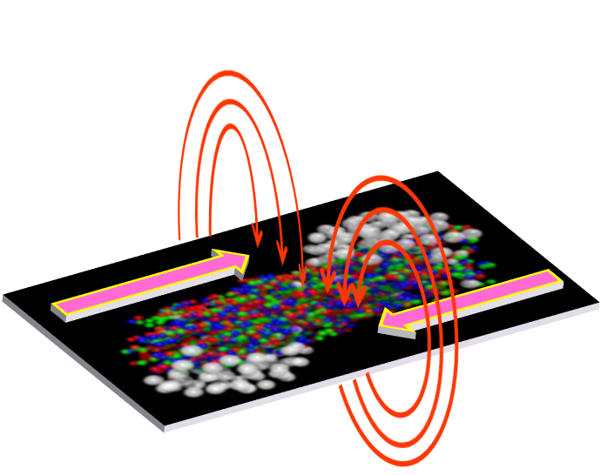
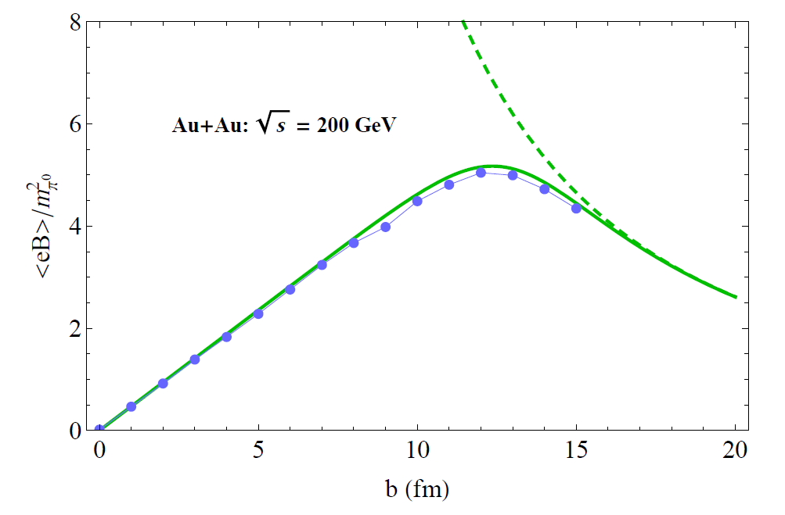
Strong magnetic field induce by heavy-ion collisions
Impact parameter
Deng & Huang (2012), KH, & Huang (2016)

Slide 3
1. Heavy Quark Diffusion Dynamics in QGP
K. Fukushima (Tokyo), KH, H.-U. Yee (UIC), Yi Yin (BNL→MIT),
Phys. Rev. D 93 (2016) 074028. arXiv:1512.03689 [hep-ph]
Cf.) KH and Xu-Guang Huang, arXiv:1609.00747 [nucl-th]
2. Ohmic conductivity in QGP
KH, Shiyong Li (UIC), Daisuke Satow (Frankfurt), Ho-Ung Yee, arXiv:1610.06839 [hep-ph]
KH and Daisuke Satow, Phys. Rev. D 94 (2016). arXiv:1610.06818 [hep-ph]
3. Novel anomalous transport from magneto-vorticity coupling
KH and Yi Yin, Phys. Rev. Lett. 117 (2016) 15, arXiv:1607.01513 [hep-th]

Slide 4
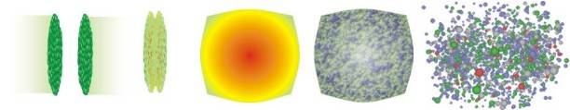
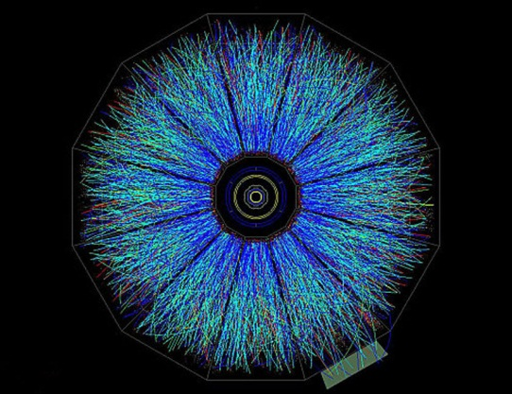
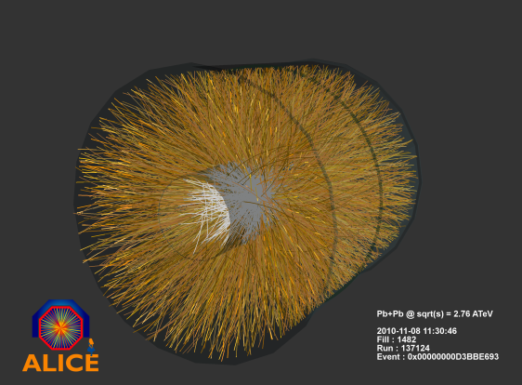
1. Heavy quark as a probe of QGP
g
g
Thermal Quark-Gluon Plasma (QGP)
Hadrons
Non-thermal heavy-quark production in hard scatterings
RHIC
Momentum distribution of HQs in log scale
Initial distribution (τ = 0)
from pQCD
LHC
Thermal (τ = ∞)
Relaxation time is controlled by transport coefficients (Drag force, diffusion constant)

Slide 5
Heavy quark (HQ) dynamics in the QPG
-- In soft regime
Langevin equation
Random kick (white noise)
Einstein relation
Drag force coefficient: η_{D}
Diffusion constant: κ
Perturbative calculation by finite-T field theory (Hard Thermal Loop resummation)
LO and NLO without B are known (Moore & Teaney, Caron-Huot & Moore).

Slide 6



Perturbative computation of momentum diffusion constant
Momentum transfer rate in the LO Coulomb scatterings
2
2
2
2
+
+
HQ
HQ
HQ
Thermal quarks
HQ
Thermal gluons
Thermal quarks
Thermal gluons
c.f.) LO and NLO without B (Moore & Teaney, Caron-Huot & Moore)
Effects of a strong magnetic field (eB >> T^2)
1. Modification of the dispersion relation of thermal quarks
2. Modification of the Debye screening mass

Slide 7
Schematic picture in the strong field limit
Wave function
Fermions in 1+1 dimension
Gluon self-energy
Schwinger model
Strong B
+ There is no T or μ correction in massless Schwinger model
+ Mass correction is small ~ m/T

Slide 8
Kinematics in the strong field limit
Massless limit for high temperature, m_{q} << T
-- For (1+1)-D massless fermion, momentum transfer
along B is strictly prohibited.
-- Implies a large anisotropy.
2. Finite contributions to κ|| will come from
current quark mass correction and gluon contribution.

Slide 9

Prohibition of the longitudinal momentum transfer
Massless limit
Linear dispersion relation
Spatial momentum transfers in the direction of B
From the chirality conservation
Static limit (or HQ limit)
HQ
Light quark

Slide 10
Transverse diffusion constant in massless limit
Distribution of the quark scatterers
Screened Coulomb scattering amplitude (squared)
Spectral density

Slide 11
Longitudinal diffusion constant
1. Current quark mass correction
2. Gluon contribution
Same as Moore & Teaney up to constants
Comparison between two contributions

Slide 12
Anisotropic momentum diffusion constant
Remember the density of states in B-field.
In strong field limit,
Cf. Computation by strong-coupling theory
S. Finazzo, R. Critelli, R. Rougemont, J. Noronha, arXiv:1605.06061

Slide 13
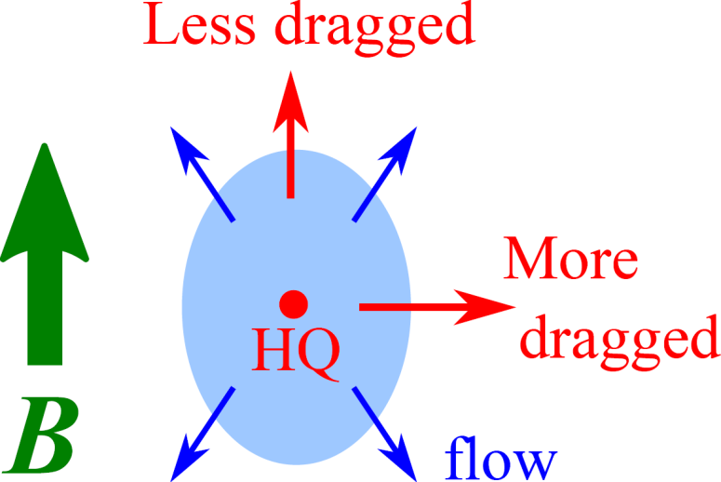
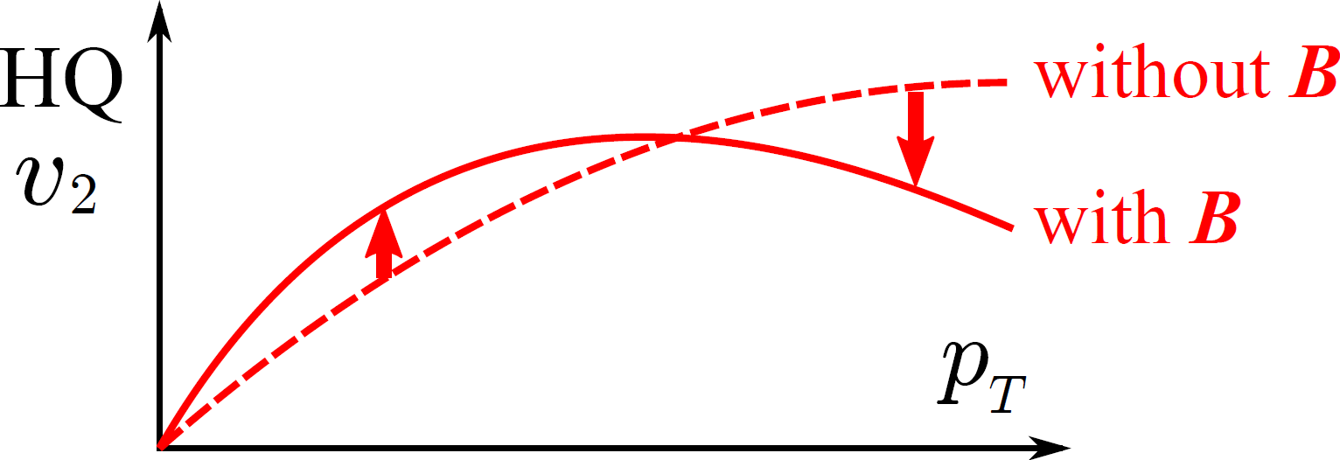
Implication for v2 of heavy flavors
Magnetic anisotropy gives rise to v2 of HQs
even without v2 of medium.
→ Possible to generate v2 of HQs in the early QGP stage.

Slide 14
2. Ohmic conductivity in strong magnetic field
V
Strong B

Slide 15
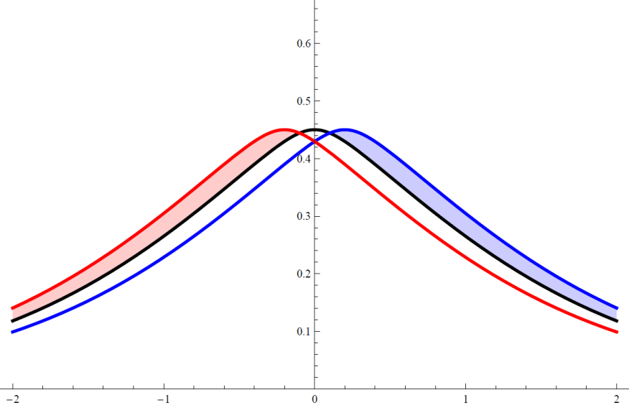
“Longitudinal conductivity” in the strong B
Current only in z direction
Boltzmann eq.
Total current integrated over p_{z}

Slide 16
How linearized Boltzmann eq. works
LHS
Stationary and homogeneous limit
Driving term due to the external electric field
RHS
Collision term: e.g., relaxation time approximation
Linearized Boltzmann eq.
Solution

Slide 17
Collision term from microscopic theory
Perturbation theory
Finite B opens 1-2 processes

Slide 18
Chirality selection in the massless limit
Energy-momentum conservation in 2D
RH antiparticle
RH particle
RH particle
RH particle
Gluon emission in a collinear configuration
Transverse gluons

Slide 19
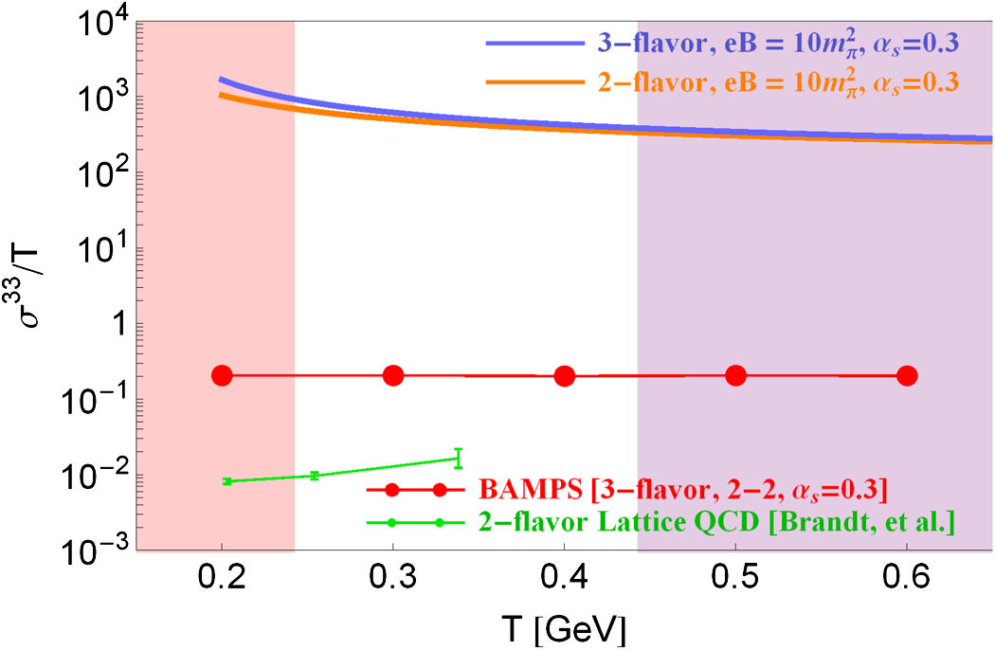
Results
+ Density of states
+ Chirality conservation
in 1-2 (2-1) processes
+ IR cutoff
No need to Iterate Boltzmann eq.
Transition from strong B (LLL)
to weak B (Effects of hLL).

Slide 20
Consistent result from diagrammatic calculation
KH, D. Satow
Response function
Kubo formula
Divergence in free theory
No need to resum the pinch singularity in the present case
+
+
+ ・・・

Slide 21
3. Anomaly-induced transport from magneto-vorticity coupling
Chiral magnetic effect:
Chiral vortical effect:
Coefficients are time-reversal even. → Non-dissipative transport phenomena
is due to topology in quantum anomaly and is nonrenormalizable.
Anomaly coefficient

Slide 22
Consistent predictions from fundamental and effective theories
Anomalous hydrodynamics due to Son and Surowka
QFT
Anomalous transport
Chiral kinetic theory
The coefficients are determined by the second law
of thermodynamics.
Q: What about the second order in the derivative expansion
in a strong B and a still perturbative vorticity?

Slide 23
Shift of thermal distribution functions
Spin-vorticity coupling
Spin alignment in magnetic field for particle (upper) and antiparticle (lower).
Shift if independent of the chirality (Determined only by the spin direction)
Size of the spin

Slide 24
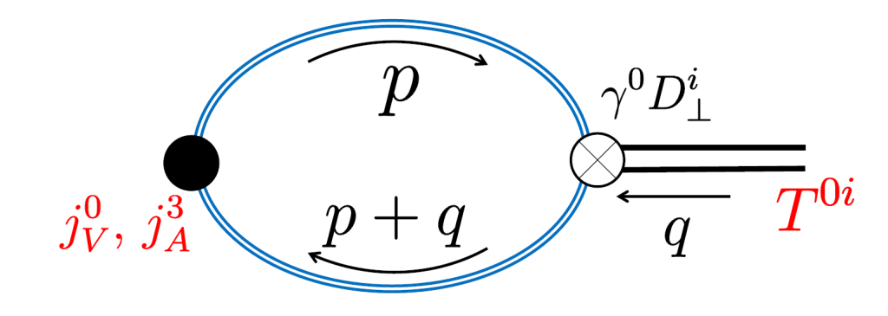
Field-theoretical computation by Kubo formula
There is no T or μ correction in the massless limit!
→ Consistent with the previous observation from the shift of distributions.

Slide 25
Summary
We investigated non-anomalous and anomalous
transport phenomena.
Non-anomalous: Heavy-quark diffusion and Ohmic conductivity
Anomalous: Magneto-vorticity coupling
The LLL particles are chiral, and the chirality selection
plays crucial roles.
Outlook
Computation in the weak field limit as a step toward
including the time dependence of the B-field.

Slide 27
Causality problem:
A rigid rotation of an infinite-size system breaks
causality in the peripheral region.
One must have a finite-size system with an exterior boundary
or a local vortex field.
L
R
Local shift of the charge density
→ Redistribution of charge in the system

Slide 28
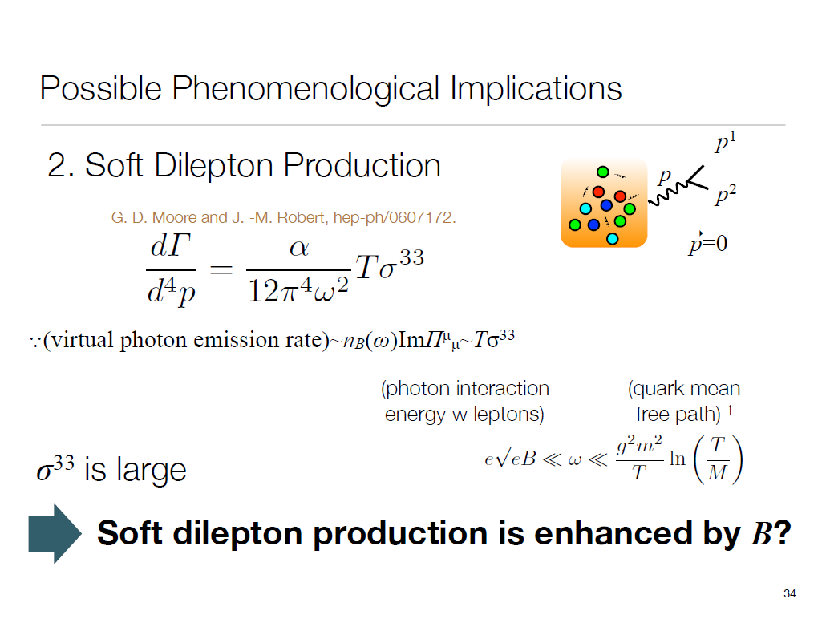
From Daisuke Satow’s slides

Slide 29
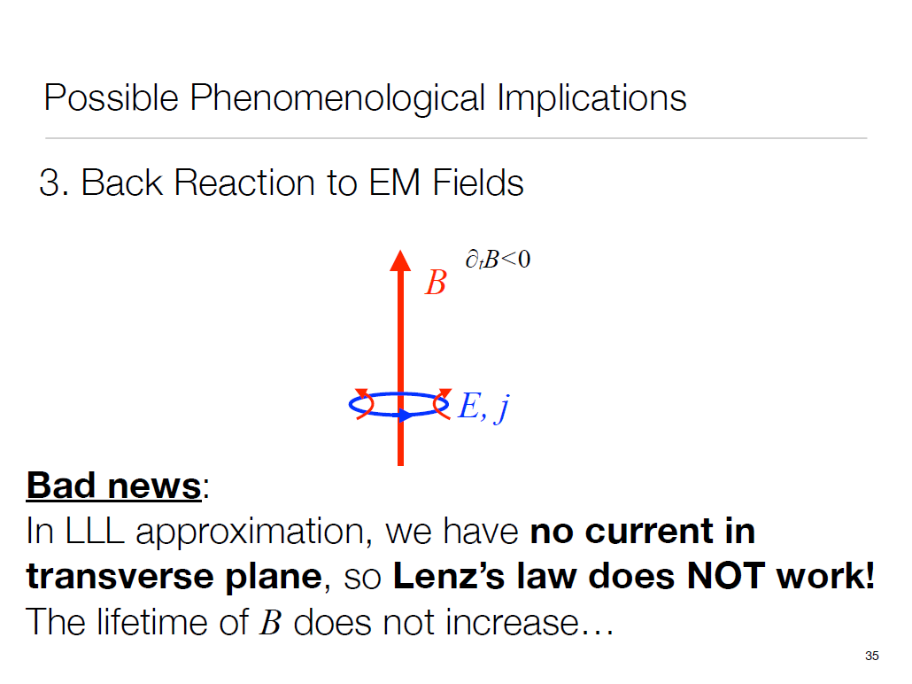
From Daisuke Satow’s slides

