Slide 1
How to measure the gluon orbital angular momentum
Yoshitaka Hatta
Yukawa institute, Kyoto U.
with Yuya Nakagawa, Feng Yuan, Yong Zhao arXiv:1612.02445

Slide 2
Contents
Nucleon spin decomposition
Orbital angular momentum and Wigner distribution
Method to measure the gluon OAM at small-x

Slide 3
The proton spin problem
The proton has spin ½.
The proton is not an elementary particle.
Quarks’ helicity
Orbital angular
Momentum (OAM)
Gluons’ helicity
In the quark model,
with relativistic effects,
EMC result (1987)
Current value

Slide 4
from polarized DIS
Longitudinal double spin asymmetry in polarized DIS

Slide 5
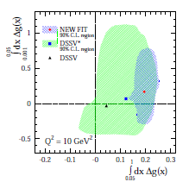
Gluon polarization
Result from the NLO global analysis
after the RHIC 200 GeV pp data
DeFlorian, Sassot, Stratmann, Vogelsang (2014)
HUGE uncertainty from the small-x region
→ RHIC 510GeV,
Electron-Ion Collider

Slide 6


QCD angular momentum tensor
QCD Lagrangian → Lorentz invariant
→ Noether current
QCD angular momentum tensor
quark helicity gluon helicity
canonical energy momentum tensor
→ Quark OAM → Gluon OAM

Slide 7




Jaffe-Manohar decomposition
Based on the canonical angular momentum tensor
Operators NOT gauge invariant.
Partonic interpretation in the light-cone gauge
cf. kinetic OAM by Ji

Slide 8
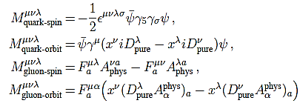
Complete decomposition
Chen, Lu, Sun, Wang, Goldman (2008)
Wakamatsu (2010)
YH (2011)
where
(my choice)
Gauge invariant completion of Jaffe-Manohar

Slide 9





Can we measure ?
A big challenge for the whole community.
No observable proposed so far…although OAM is the future of spin physics!
Hint1: We need to introduce the x-distribution for OAMs
Hint2: is related to the Wigner distribution
The gluon Wigner distribution is measurable at low-x. YH, Xiao, Yuan (2016)
cf. ,
Recent breakthrough
small-x YH, Nakagawa, Yuan, Zhao arXiv:1612.02445
moderate-x Ji, Yuan, Zhao arXiv:1612.02438

Slide 10
OAM at small-x: Does it matter?

Slide 11
OAM from the Wigner distribution
Wigner distribution in QCD
Belitsky, Ji, Yuan (2003)
Need a Wilson line !
Define
Lorce, Pasquini (2011);
YH (2011);
Which OAM is this??

Slide 12
Canonical OAM from the light-cone Wilson line
YH (2011)
Kinetic (Ji’s) OAM from the straight Wilson line
Ji, Xiong, Yuan (2012)
`Potential’ OAM
Torque acting on a quark
Burkardt (2012)

Slide 13



OAM parton distribution distribution
Define the x-distribution .
Natural, because Jaffe-Manohar decomposition has a partonic interpretation.
YH, Yoshida (2012)
??
Go to the momentm space and look for the component
Then

Slide 14
Deconstructing OAM
Ji’s OAM canonical OAM `potential OAM’
For a 3-body operator, it is natural to define the double density.

Slide 15

Ji’s OAM canonical OAM `potential OAM’
doubly-unintegrate
The gluon has zero energy,
partonic interpretation!
Canonical OAM density
YH, Yoshida (2012)
It coincides with defined
via the Wigner distribution

Slide 16
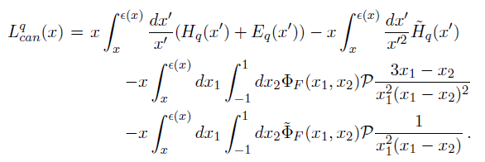
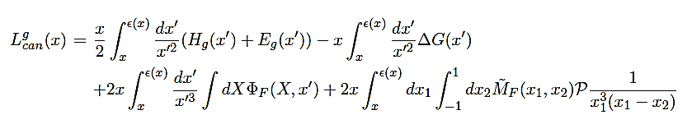

Twist structure of OAM distributions
YH, Yoshida (2012)
Wandzura-Wilczek part
Genuine twist-three part

Slide 17

Gluon Wigner distribution
There are two ways to make it gauge invariant
Bomhof, Mulders, Pijlman (2006)
Dominguez, Marquet, Xiao, Yuan (2011)
Weizsacker-Williams distribution
Dipole distribution
This was used to define gluon OAM YH(2011)
This has a better chance to be measured
YH, Xiao, Yuan (2016)
One can prove that

Slide 18
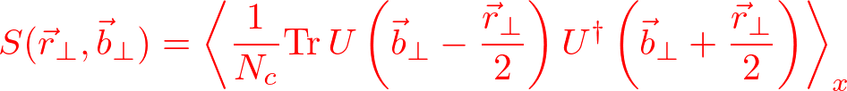
Dipole gluon Wigner distribution at small-x
YH, Xiao, Yuan (2016)
Approximate
Use the identity
``Dipole S-matrix”

Slide 19
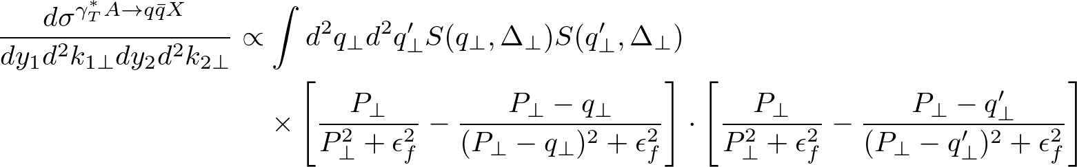

Probing Wigner in Diffractive dijet production
YH, Xiao, Yuan (2016)
Jet 1
Jet 2
Proton recoil momentum
Dijet relative momentum
Fourier transform of
(for small)

Slide 20


Where is spin dependence?
“Pomeron” “odderon”
cannot contain the structure
forbidden by PT symmetry
Reason: eikonal approximation
All the information about spin is lost…

Slide 21

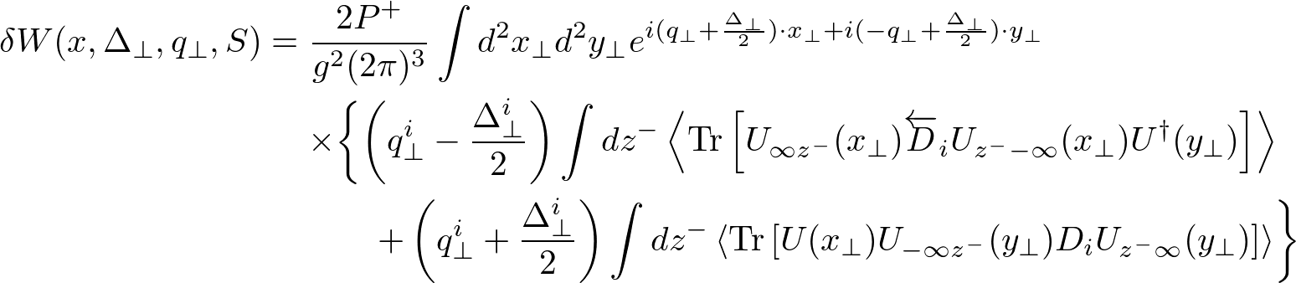
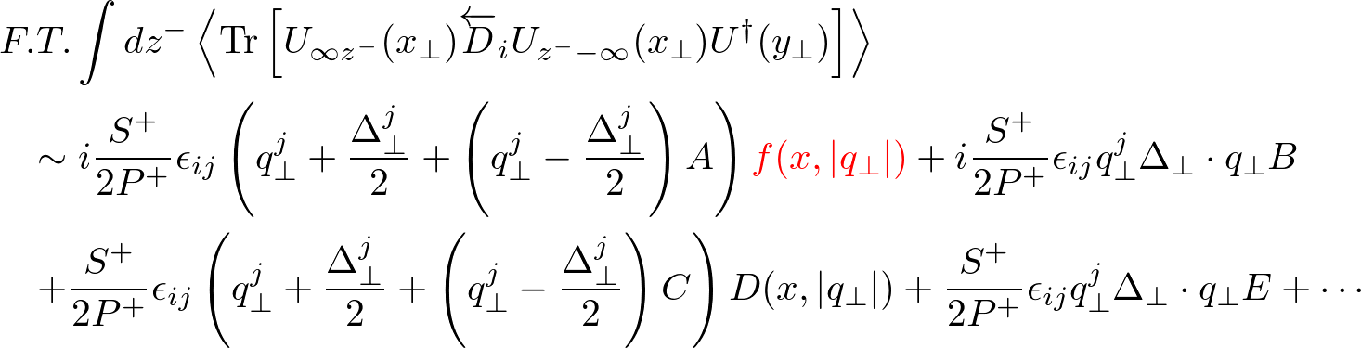
OAM as a next-to-eikonal effect
YH, Nakagawa, Yuan, Zhao arXiv:1612.02445
Parameterization of the matrix element
OAM!

Slide 22
Dijet production at next-to-eikonal
Green’s function
cf. Altinoluk, Armesto, Beuf, Martinez, Salgado (2014)

Slide 23
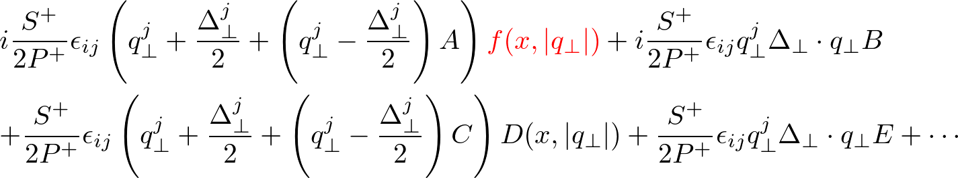
Longitudinal single spin asymmetry
2
2
-
LO
NLO
Interference between eikonal and next-to-eikonal contributions.
OAM function interferes with odderon, but Pomeron usually dominates…

Slide 24



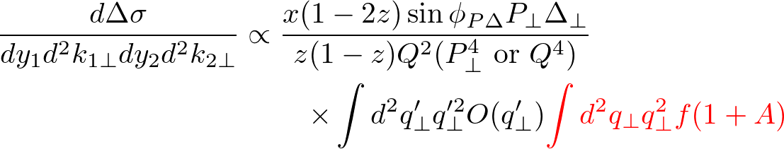
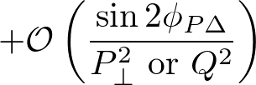

Look at the kinematic regions
Pomeron drops out because

Slide 25




Experimental signature: dependence
What is ? We don’t know…
in one-loop calculation.
Structure follows from parity
→
Two jets are indistinguishable.

Slide 26




Expected -dependence
Odderon intercept is unity.
Bartels, Lipatov, Vacca (1999)

Slide 27

Summary
Gauge invariant canonical OAMs, even their
x-distribution well defined in QCD and important.
First-ever experimental signature of parton OAM!
Measurable at the EIC
OAM—Holy Grail in spin physics
Odderon—Holy Grail in small-x physics
Kill two birds with one stone!

