Slide 1
Opportunities at JPARC
Large-x quark distributions, power counting
Longitudinal polarized quark distributions
Transversity distributions at large-x
Complementary to JLab Program

Slide 2
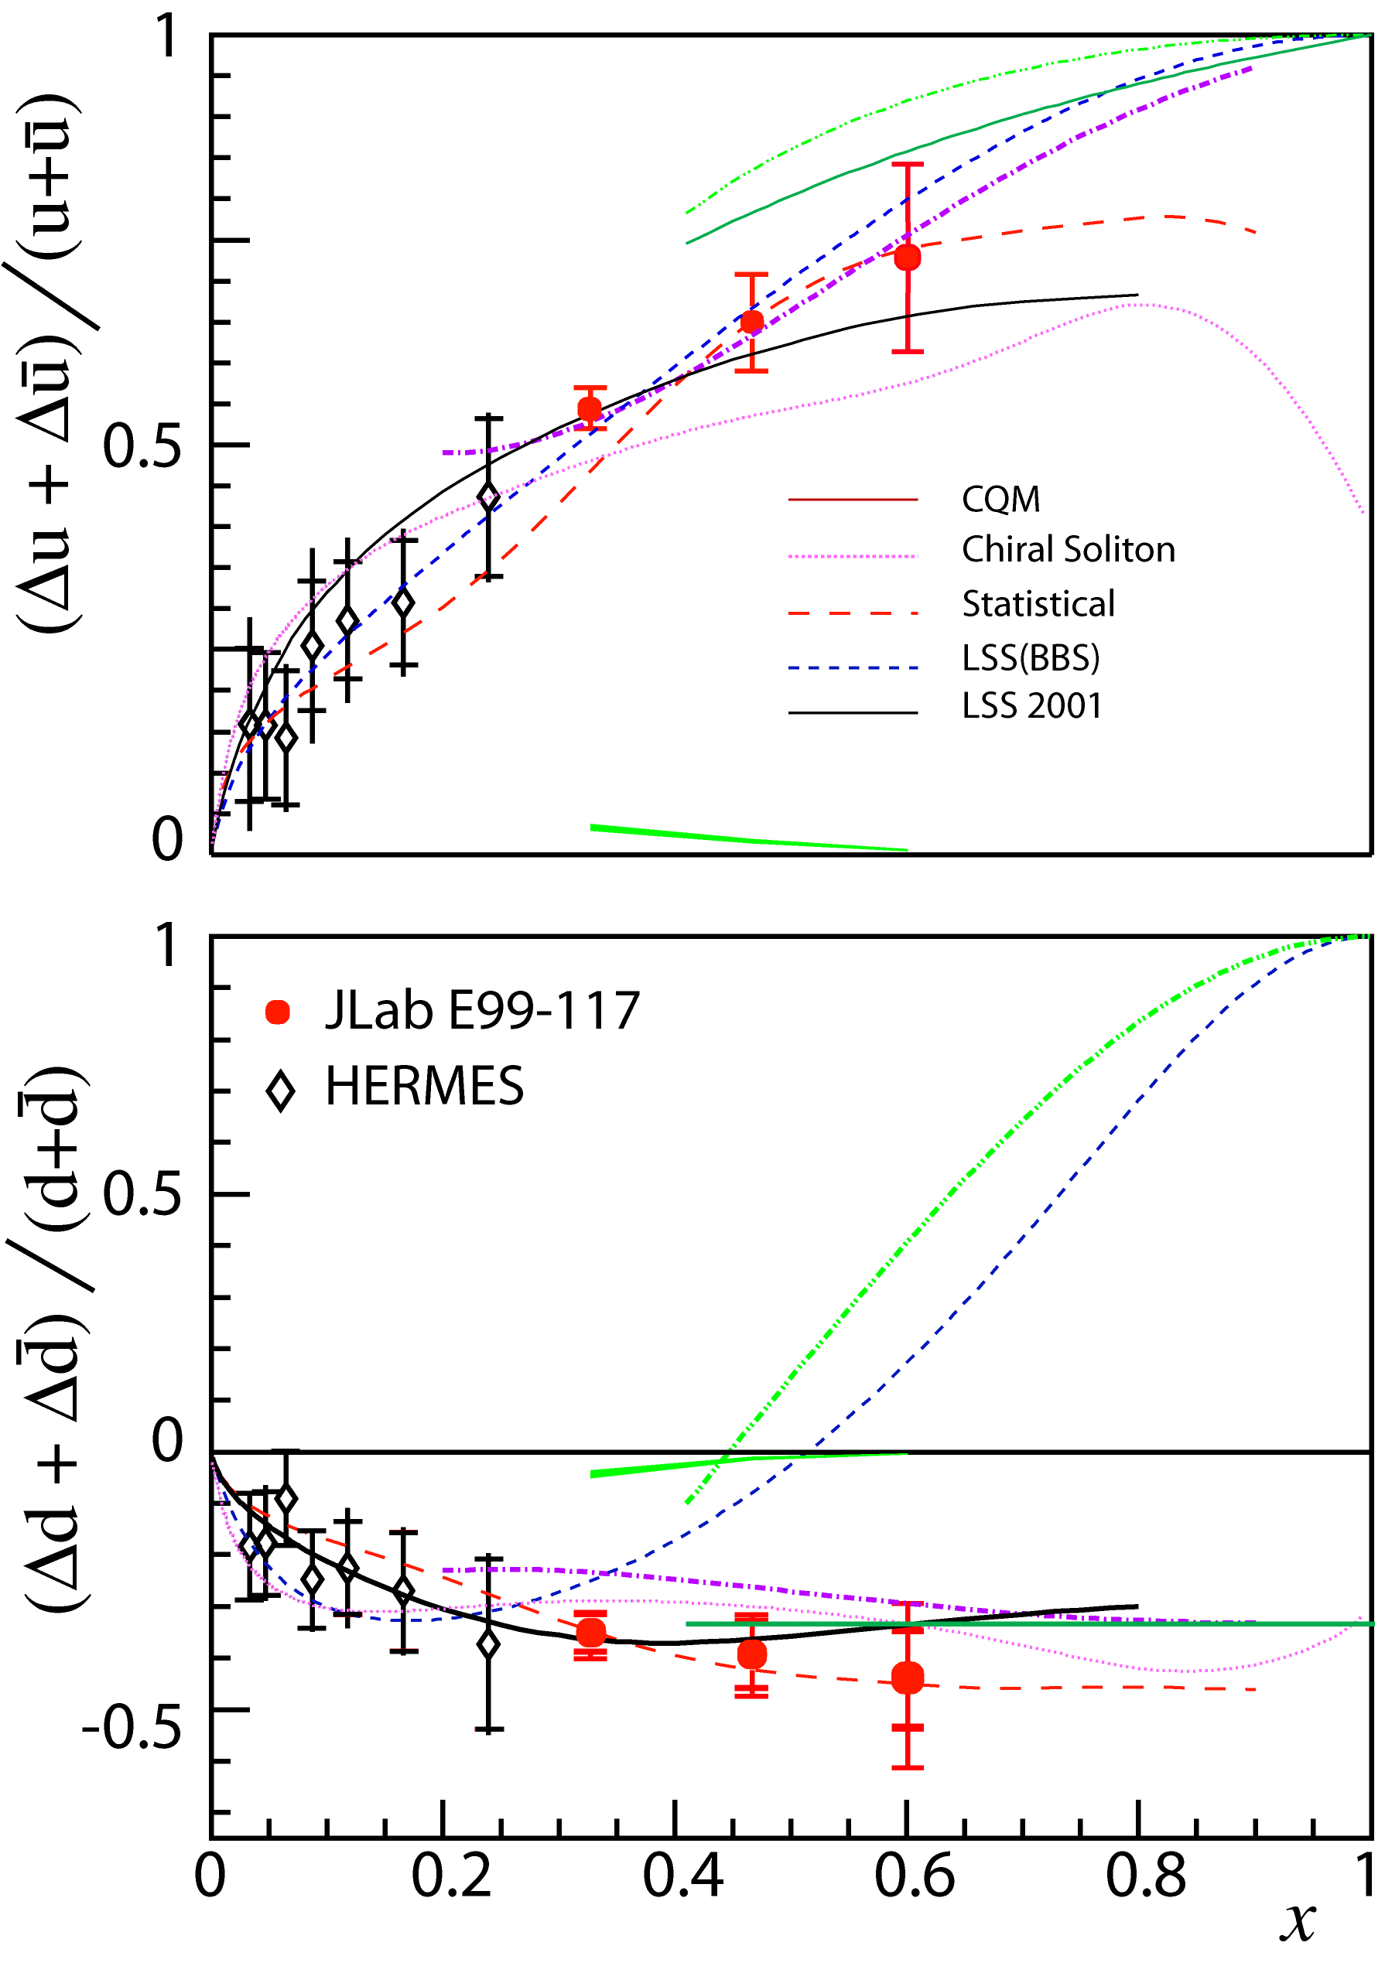
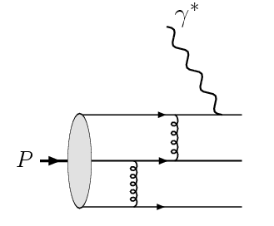
Quark polarization at large-x
JLab Hall A, PRL04
The QCD configuration of the proton wave function becomes far off-shell and can be treated from perturbative QCD
Power counting rule:
q⁺~(1-x)³, q⁻~ (1-x)⁵
Farrar-Jackson, 75
Brodsky-Lepage, 80
Brodsky-Burkardt-Schmidt, 95

Slide 3
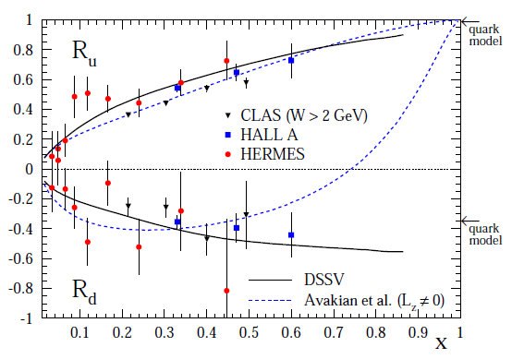
Quark orbital angular momentum contribution at large-x
Power counting rule
Brodsky-Burkardt-
Schmidt 95
q⁻/q⁺~ (1-x)²
Quark-orbital-angular
Momentum contribution
Avakian-Brodsky-Deur-Yuan,07
q⁻/q⁺~(1-x)² log²(1-x)
It will be interested to see how this compares with
the future data from RHIC and JLab
Notes:
In the original power counting analysis, the contribution from the S-wave state was considered only. However, after taking into account the non-zero orbital angular momentum component of the proton wave function, we found the negative quark helicity distirbution will receive logarithmic enhancement

